Slide 1
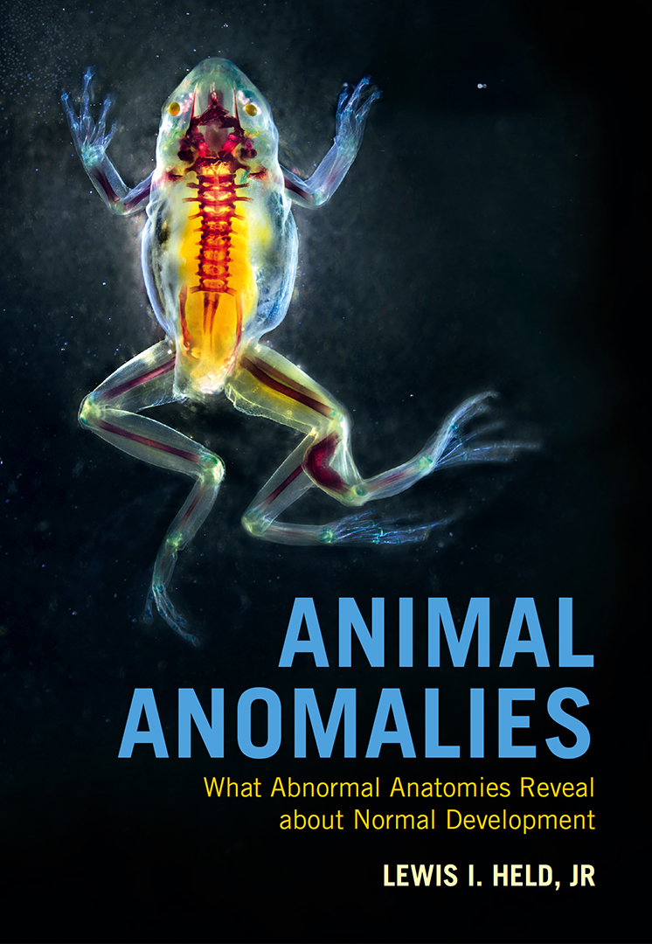
Notes:
What follows when you select the 'next page' arrow (upper left on each page) are commentaries on the evolution and etiology of some peculiar phenotypes of mutant fruit flies. All 30 figures are excerpted from the new book Animal Anomalies published by Cambridge University Press, March, 2021. The field of evo-devo (evolutionary developmental biology) has recently been solving age-old mysteries of animal evolution by providing genetic explanations. Key concepts from evo-devo are defined in the glossary, included in excerpts from Held's book, How the Snake Lost Its Legs. Use the arrows (or the index, below) to move forward or back among the slides. Figure legends are abbreviated. References are omitted.

Slide 2
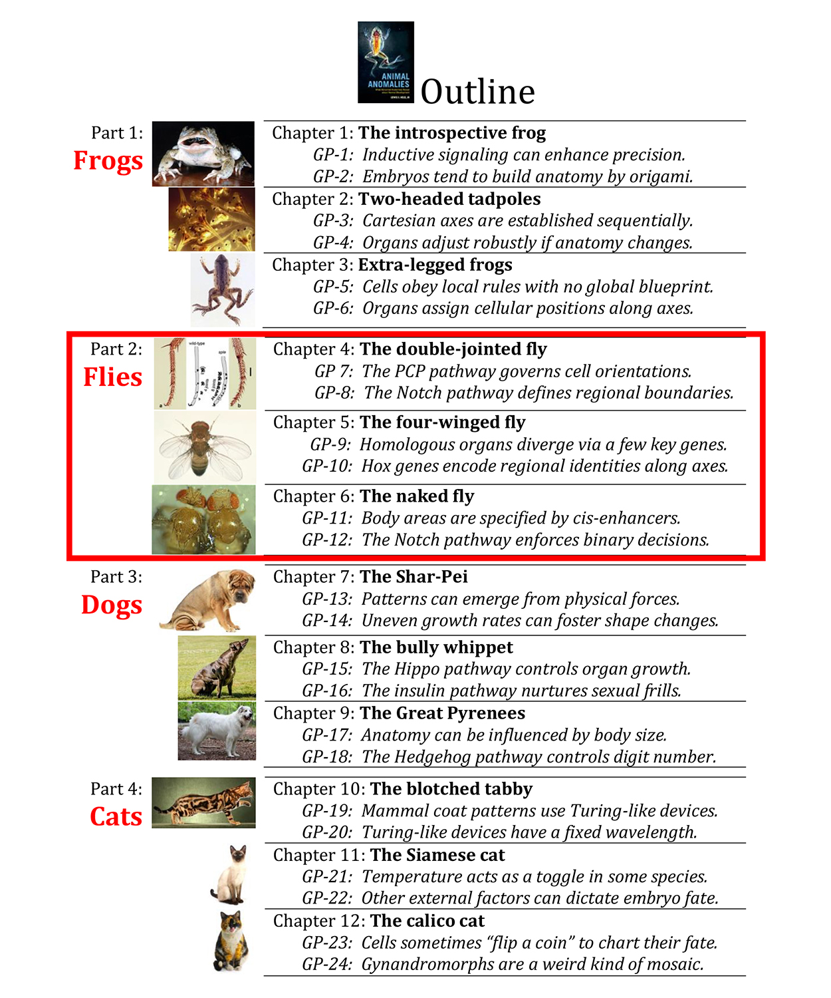
Notes:
Animal Anomalies explores aberrations in frogs, flies, dogs, and cats. Only the three fly chapters (4-6) are excerpted in subsequent slides. Each chapter distills two general principles (GPs) and gives one or more non-fly examples. Overall, there are 12 chapters and 24 GPs. Similar principles are covered in developmental biology textbooks, but the less formal case-study approach used here is driven by curiosity more than by pedagogy.

Slide 3
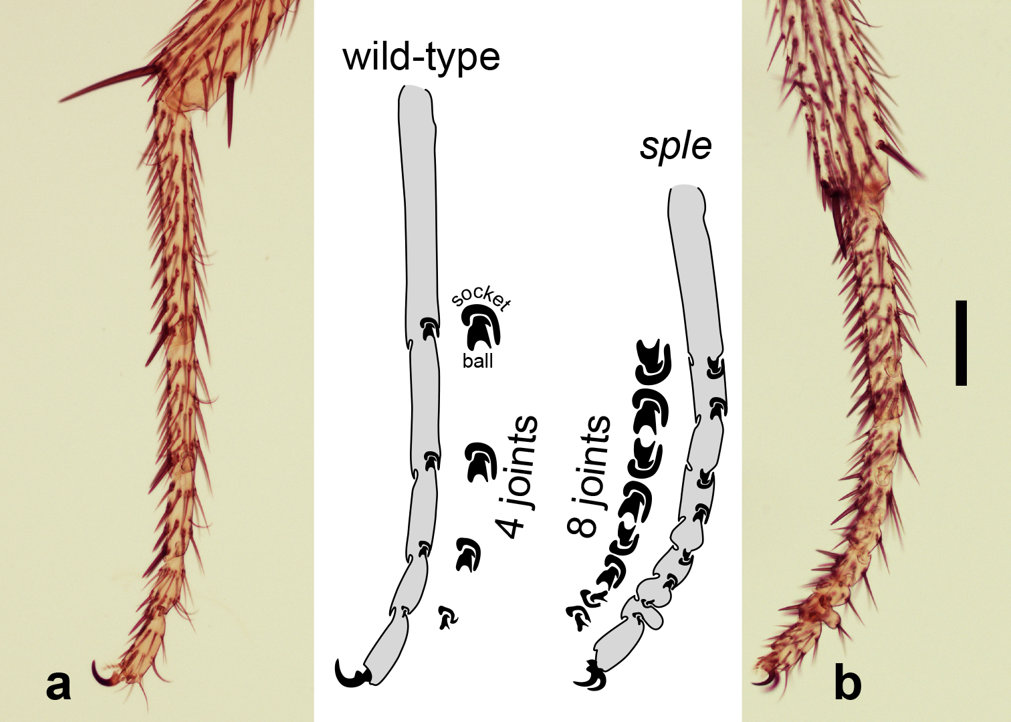
Chapter 4
What causes this
extra-joint defect?
Notes:
Double-joint syndrome. Left midleg tarsus of a wild-type fly (a) compared to that of a fly homozygous for the spiny legs (sple) allele of the prickle (pk) gene (b). Anterior is up, and ventral is to the left. Scale bar (b) = 100 microns. Tracings depict cross-sections with ball-and-socket joints (outlines). Insets are enlarged two-fold. The mutant tarsus (b) has twice as many joints, and the extra ones are upside-down. What could be causing such an odd phenotype? The pk gene acts in the Planar Cell Polarity (PCP) pathway, and the pk^{sple} mutation also affects bristle polarities, as indicated by the name “spiny” legs. Similar phenotypes are caused by mutations in other PCP pathway genes, including frizzled, dishevelled, and inturned, and an analogous (“segment polarity”) syndrome of extra, inverted boundaries is also seen for larval body segments in the mutant patched. Flies with twice as many joints walk normally, which is not surprising considering that the tarsus is operated ”at a distance” via a tendon like a marionette by muscles in the tibia. The same sort of strategy is used for our own fingers, which are operated by muscles in our forearm via tendons in our hands. If a similar mutation were to double our knuckles, it would not diminish our dexterity. On the contrary, guitarists might love it! Nonetheless, no such “Jimi Hendrix” syndrome has shown up yet in humans.

Slide 4
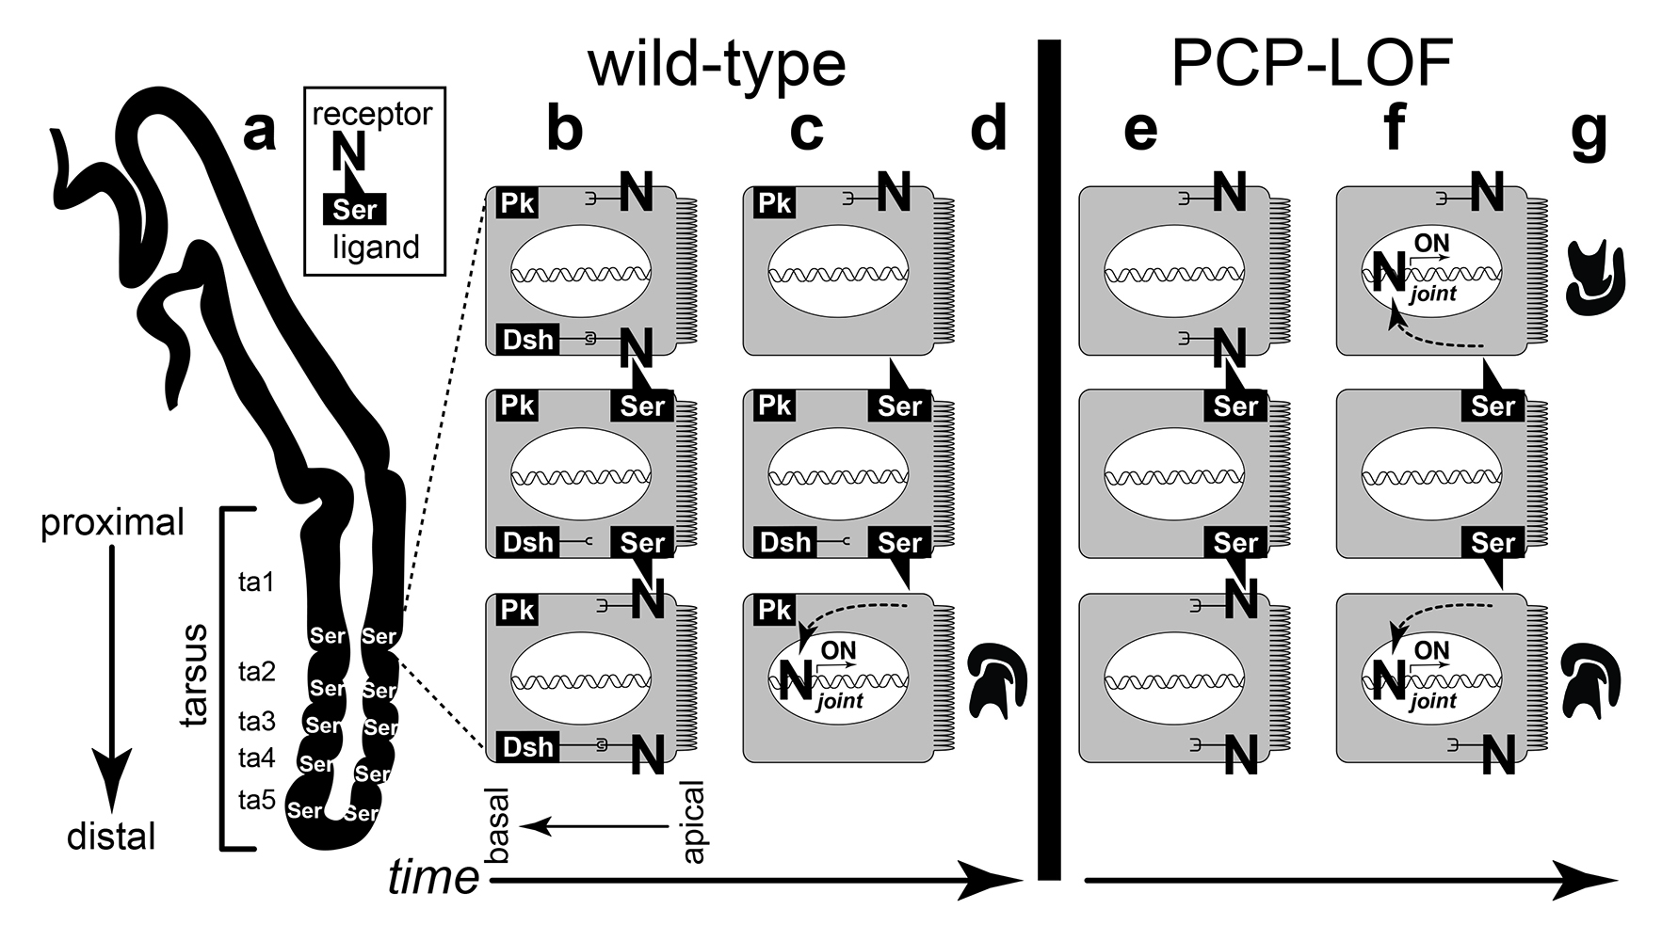
Notes:
Explanation for why mutations in PCP genes cause extra joints. The clue to solving this mystery turned out to be the way that the PCP pathway controls the Notch pathway at segment boundaries. a. Partly everted left D. melanogaster midleg. The thick outline represents the one-cell-thick epidermis in cross section. Joints form on the dorsal side (to the right). Serrate (Ser) is expressed at the distal end of each leg segment, as is Delta (Dl; not shown), but only the tarsal rings (ta1-ta5) are labeled. Inset: Abstract ligand-receptor fit between Ser and Notch (N), both of which are transmembrane proteins. b-c, e-f. Schematic enlargement of three adjacent cells (gray rectangles) at the ta1/ta2 juncture (dorsal face), with microvilli on the apical (cuticle-secreting) face, nucleus (white oval), DNA (double helix) and key proteins (black rectangles or “N”) indicated. b-c. Wild-type leg. b. Prickle (Pk) and Dishevelled (Dsh) reside at the proximal or distal side respectively. Ser binds N in both abutting cells. c. After binding Ser, the inner part of the N protein of the distal neighbor goes to the nucleus and turns ON joint-creating genes, but the N protein of the proximal neighbor undergoes endocytosis instead due to its link with Dsh. d. A joint arises distally but not proximally. e-f. PCP-LOF leg. e. LOF mutations in pk or other PCP genes disrupt the asymmetric partitioning of Dsh, thus preventing Dsh from inhibiting N. f. Without Dsh, N proteins of both the proximal and distal cells turn ON joint-creating genes. g. A joint forms proximally as well as distally. This diagram is oversimplified insofar as other PCP proteins are omitted, and distinctions between Pk isoforms are ignored

Slide 5
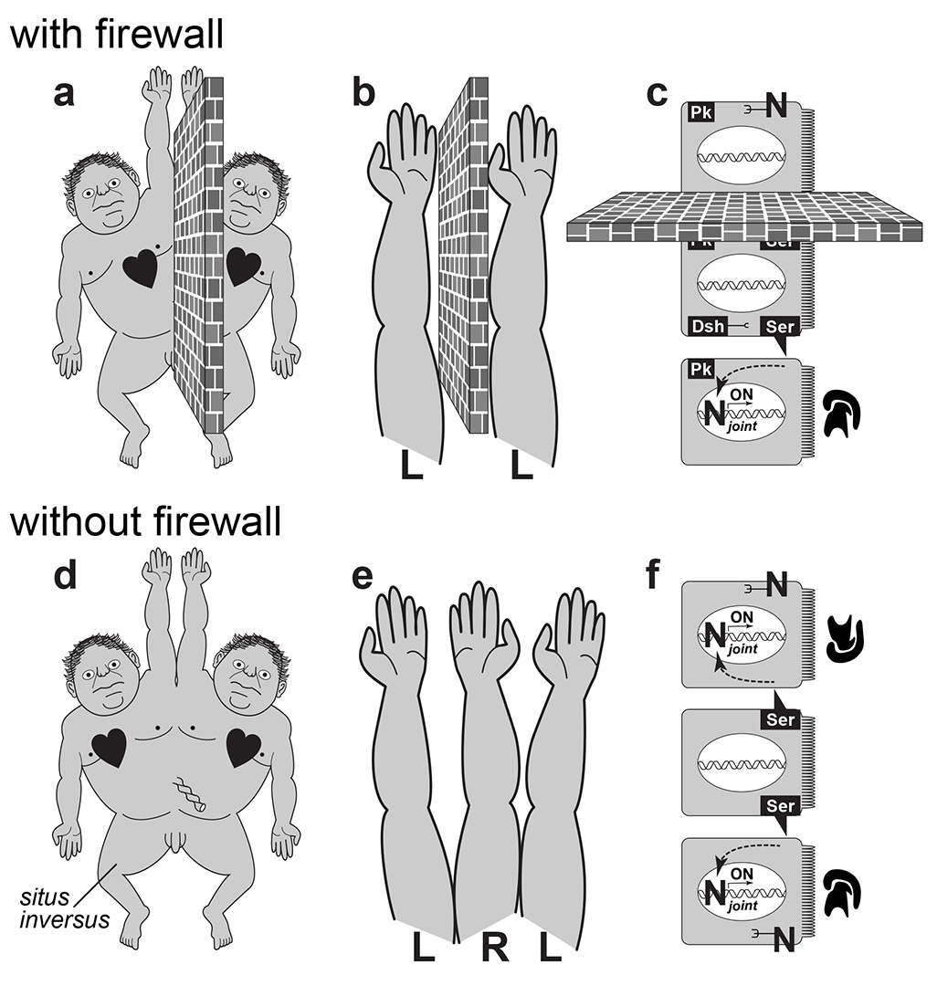
Notes:
Phenotypic effects of “firewall” failure in various contexts. The explanation for double-joint syndrome turns out to be generalizable to other symmetry-related anomalies. Barriers to intercellular signaling (cartooned as brick walls) can insulate embryonic fields from one another so as to ensure independent development (a-c). Hence, removing those obstacles promotes the emergence of new symmetry planes at unusual sites (d-f). Several such symmetry phenomena have remained enigmatic until recently. a, d. Falkenberg’s Rule was formulated in 1919 and solved in 1996 by Michael Levin et al. It set forth the mystery of why situs inversus (reversed asymmetry of the heart, etc.) should arise in 50% of the right twin in conjoined twin pairs where the twins develop side-by-side. The etiology involves the ability of morphogens to migrate laterally from the right to the left twin. b, e. Bateson’s Rule was formulated in 1894 and solved in 2019 by the author and Stan Sessions. William Bateson inventoried cases of triplicated limbs in insects, crustaceans, and humans. This rule, named after him, posed the question of why incipient limbs of the same handedness (e.g., L/L) should evoke an interposed limb of opposite handedness (L/R/L) when they develop side-by-side. The etiology involves the ability of morphogens to ooze from one limb to another (L → L) in the same socket—thus establishing an inverted axis of positional information (R) between them (L/R/L). c, f. Double-joint syndrome was formulated in 1986 and solved in 2012 by Amalia Capilla et al. N.B.: It is not barriers per se, but rather the edges of isolated territories that confine the diffusible signals in Falkenberg’s Rule (perimeter of the embryo) and Bateson’s Rule (perimeter of the limb-forming domain).

Slide 6
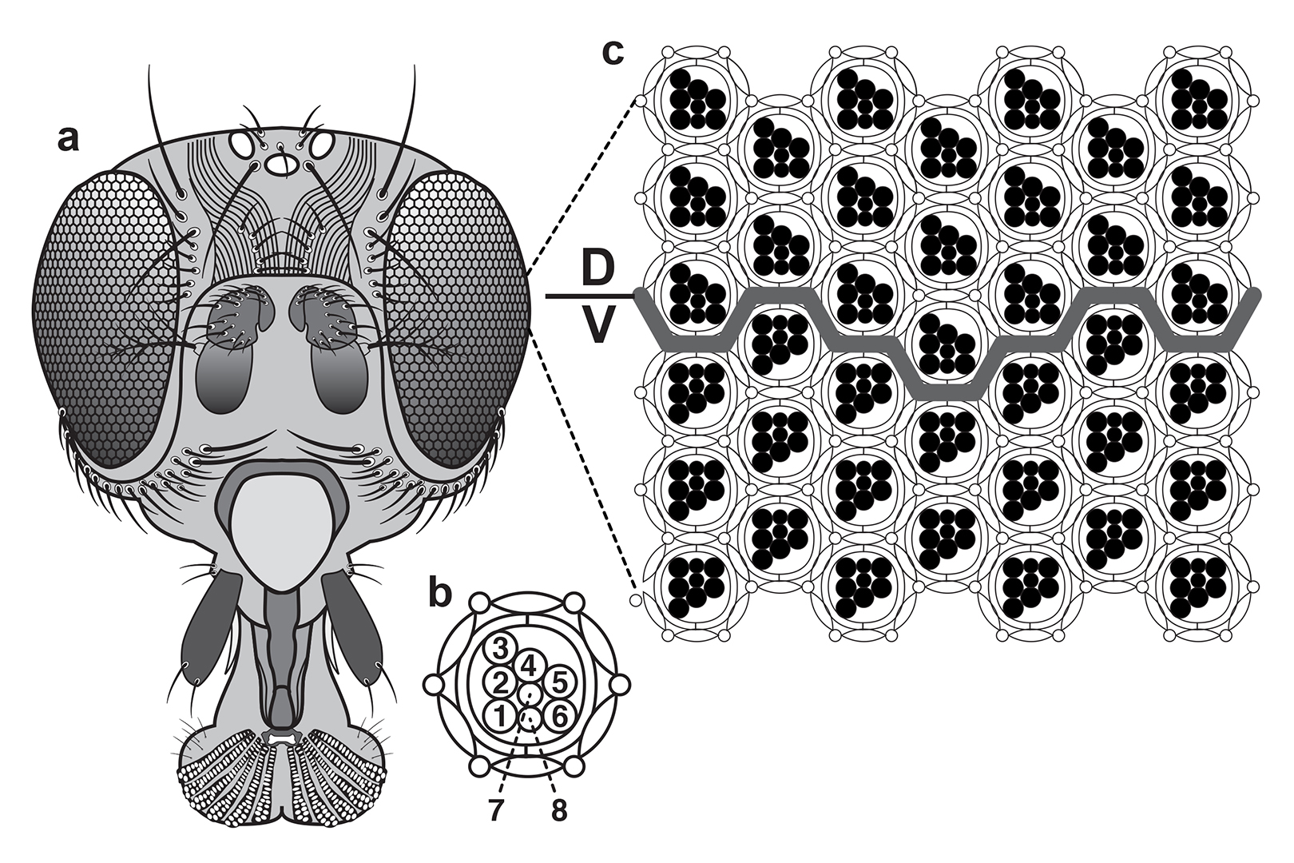
Notes:
Mirror symmetry in the fly eye. Secondary symmetry planes (those that do not span the body midline) do not just exist in mutant syndromes. They occur naturally in certain organs. The fly eye is a perfect example. a. Head of an adult fly. Each eye has ~750 ommatidial facets. b. Cross-section of one ommatidium, showing its trapezoid of photoreceptors (numbered) and accessory cells (outlines). c. Cross-section of a sample area that straddles the equator (gray line). Note that trapezoids in the dorsal (D) region point up, while those in the ventral (V) region point down. The mirror plane between them defines the equator, which zigzags across the eye in a roughly straight line. It turns out that this mirror plane arises by the same sort of PCP pathway modulation that causes extra-joint syndrome, as shown in the following figures.

Slide 7
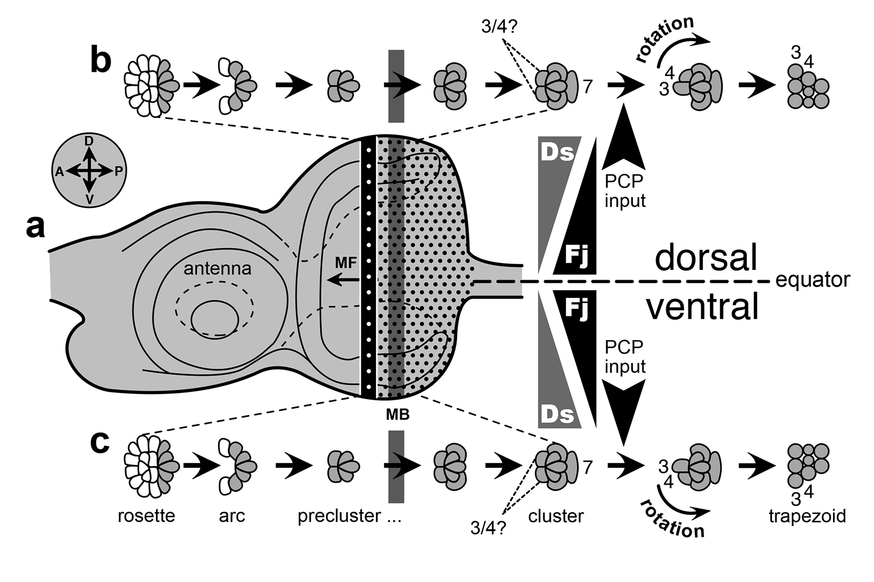
Notes:
Stages of ommatidial development. Initially, the photoreceptor clusters of the fly eye all point in the same direction, but they are forced to turn in opposite directions due to Ds and Fj morphogen gradients emanating from the equator (PCP input). a. D. melanogaster eye disc near the end of the third larval instar. Inset gives compass directions relative to the body: anterior (A), posterior (P), dorsal (D), ventral (V). The A half of the disc will form the antenna. Ommatidia (dots) arise at regular intervals within the morphogenetic furrow (MF) as it sweeps across the disc from P to A. D and V halves of the eye differ in the expression of regional identity genes within the Iriquois Complex (not shown). Reciprocal gradients (at right) of the global PCP regulators Dachsous (Ds) and Four-jointed (Fj) somehow allocate PCP proteins within each cell. b, c. Stages in the assembly of the 8-cell photoreceptor cluster. White ovals denote cells that later blend back into the epithelium; gray ovals are incipient photoreceptor cells. Rosette, arc, and precluster stages contain R2, R3, R4, R5, and R8 precursors. The remaining receptor cells (R1, R6, and R7) are born in the mitotic band (MB), which trails the MF. By the time the cluster stage is reached, the entire complement of 8 cells is present. However, cells labeled “3/4?” have not yet decided whether to become R3 or R4. That decision is biased by Fj and Ds, which recruit Pk and Dsh to opposite sides of each cell in the D and V halves of the eye. Dsh causes the cell farthest from the equator to activate its Notch receptor so as to become R4. The polarity of the R3-R4 pair dictates whether the cluster rotates clockwise (b) or counterclockwise (c) to form a D-pointing or a V-pointing trapezoid, respectively.

Slide 8
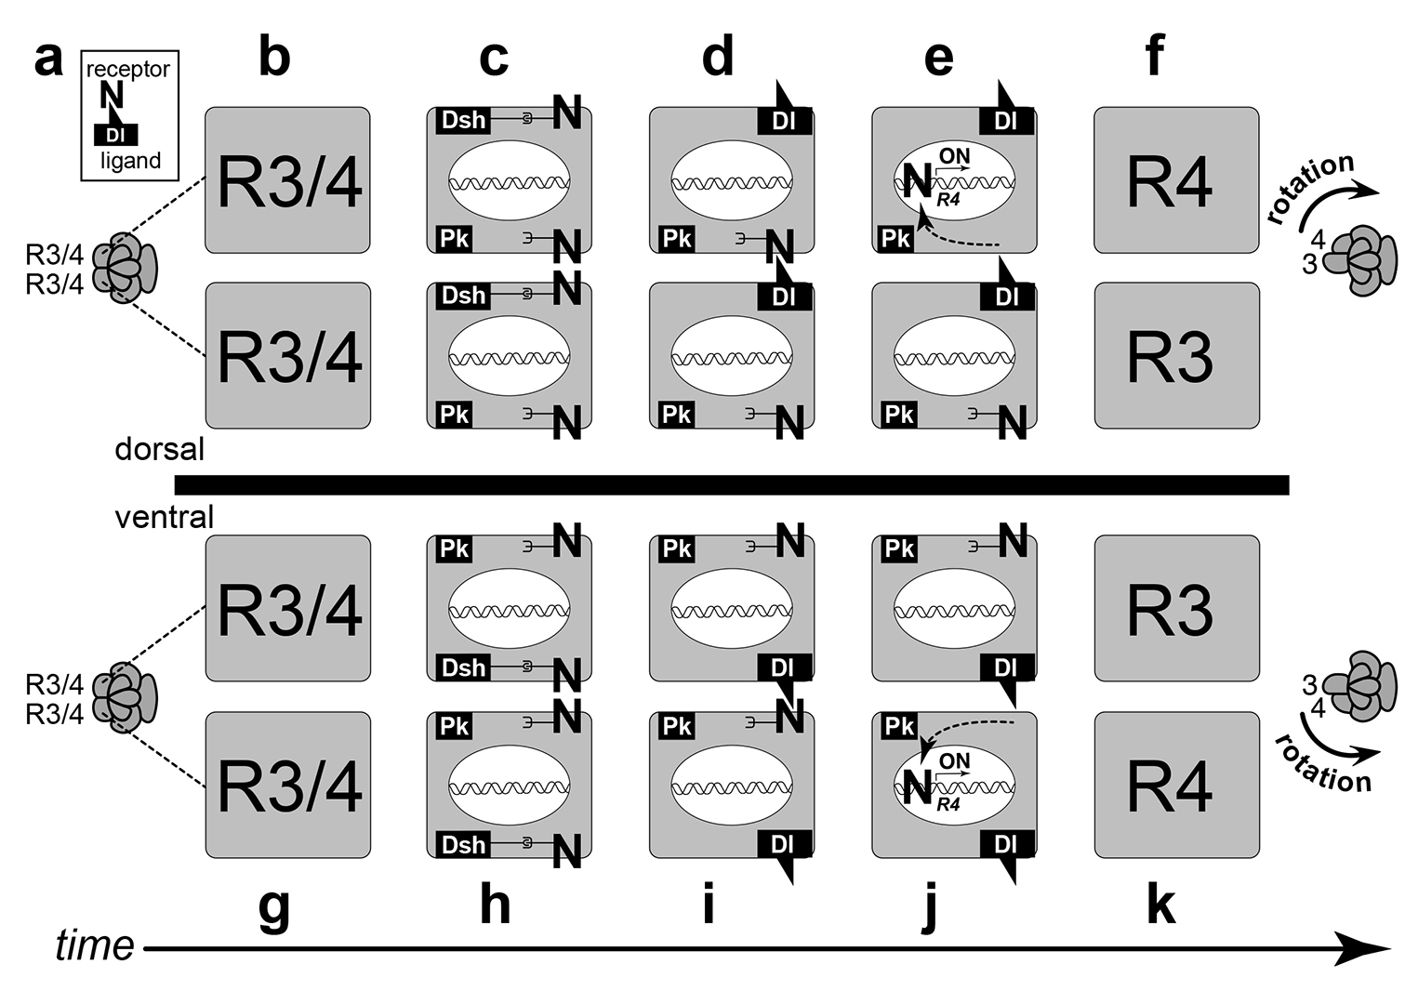
Notes:
How PCP proteins create mirror symmetry in the fly eye. Horizontal black line is the equator. a. Two cells (R3/4) in each cluster of 8 photoreceptors (gray ovals) will become R3 and R4 but are indistinguishable at this stage. Inset: Abstract ligand-receptor fit between Delta (Dl) and Notch (N), both of which are transmembrane proteins. Dl is used as the N ligand here instead of Ser. b-f. Biasing of Dl-N signaling by PCP proteins in dorsal R3/4 cells. b. Naive R3/4 cells (gray rectangles) in the dorsal half of the eye. Enlarged schematics (from a). No apical microvilli are shown because the apical-basal axis is perpendicular to this plane. c. Details of R3/4 cells: nucleus (white oval), DNA (double helix) and key proteins (black rectangles or “N”). Dishevelled (Dsh) resides on the polar (upper) side, while Prickle (Pk) resides on the equatorial (lower) side. Dsh binds Notch, but Pk does not. d. Dsh removes Notch from the membrane by endocytosis, allowing it to be replaced (via a Dl-N feedback loop) by Dl. e. Dl on the lower cell binds N on the upper cell, causing it to be cleaved from the membrane, whereupon it goes to the nucleus and turns ON R4 identity genes. f. The N-activated cell adopts R4 identity, the Dl-expressing cell adopts R3 identity, and the cluster rotates in the direction of the 3→4 vector, which in this case is clockwise. g-k. Biasing of Dl-N signaling by PCP proteins in ventral R3/4 cells. As in dorsal cells, the N-activated cell adopts R4 identity, the Dl-expressing cell adopts R3 identity, and the cluster spins along the 3→4 vector. However, in this case the direction is counter-clockwise. These opposite rotations give the eye its plane of mirror symmetry. LOF mutations in dsh, pk, or other PCP genes disorient polarity throughout the eye (not shown). N.B.: This hypothetical scenario is an oversimplification insofar as it ignores the distinct properties of Pk isoforms and the roles of Frizzled dosage and Numb expression as biasing agents in the R3-vs.-R4 decision.

Slide 9
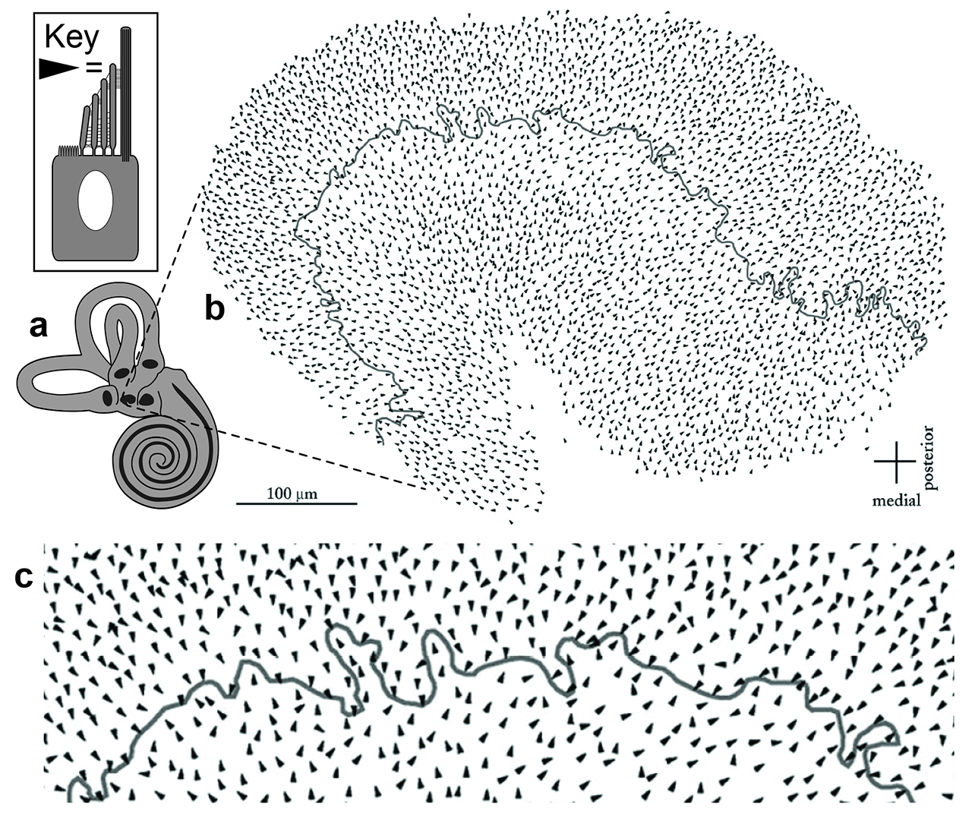
Notes:
Mirror symmetry in the mammalian utricle. Secondary planes of mirror symmetry also exist in our own body. One little-known example is found in our inner ear. a. Inner ear of a human, which resembles that of a mouse. Black spots are cristae of the semi-circular canals plus maculae of the utricle and saccule, all of which have sensory cells lining fluid-filled labyrinths. One such hair cell is sketched above with its staircase of motion-sensitive stereocilia rising to meet a thicker kinocilium. Black spiral is the sensory corridor of the cochlea. b. Macula of utricle with ~3,600 hair cells. c. Enlargement of the central part of the macula. Stereocilia bundles point toward the wiggly line, which is known as the LPR (line of polarity reversal). (Saccule vectors point away from its LPR.) Polarity is controlled by the same PCP pathway that orients ommatidia, but we don’t yet know whether these hair cells rotate relative to their initial orientations. The vector map is courtesy of Ellengene Peterson.

Slide 10
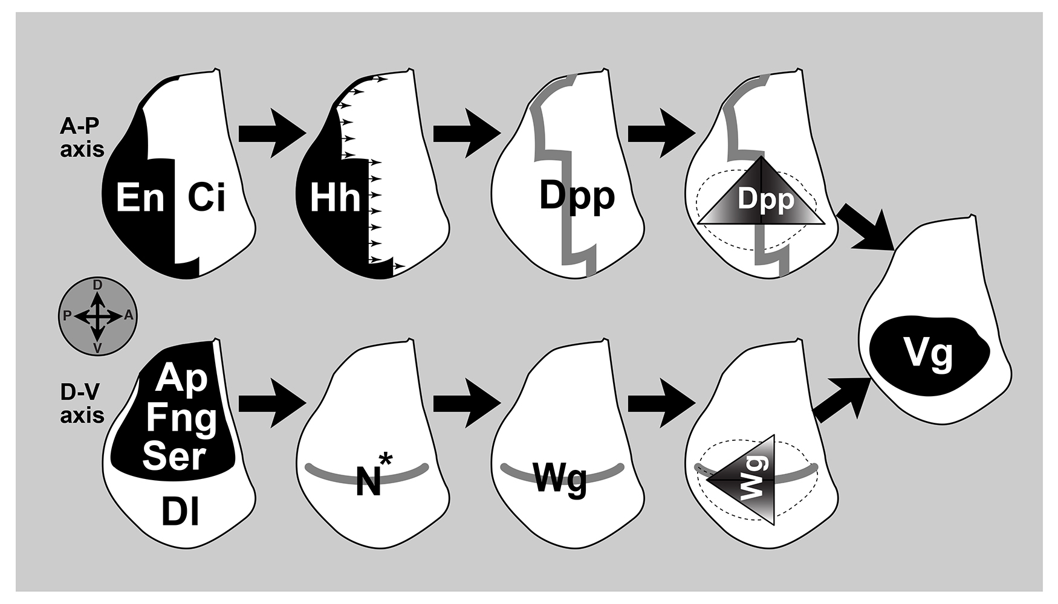
Notes:
How Notch defines the D/V boundary of the wing disc. One of the most obvious secondary planes of symmetry in the fly is found in its wing, whose upper and lower surfaces are virtually identical anatomically but arise independently developmentally with a mirror plane in between. Stages in the patterning of a right D. melanogaster wing disc (left to right), with A-P steps (above) depicted separately from D-V steps (below). Large arrows indicate causation, small arrows diffusion. The causal chains converge when Dpp and Wg gradients overlap to turn ON the wingness identity gene vestigial (vg). See text for explanation (Ci, Cubitus interruptus; N*, activated Notch). The horizontal band in the panel below marks the symmetry plane of the wing, which is examined in greater detail in the next figure.

Slide 11
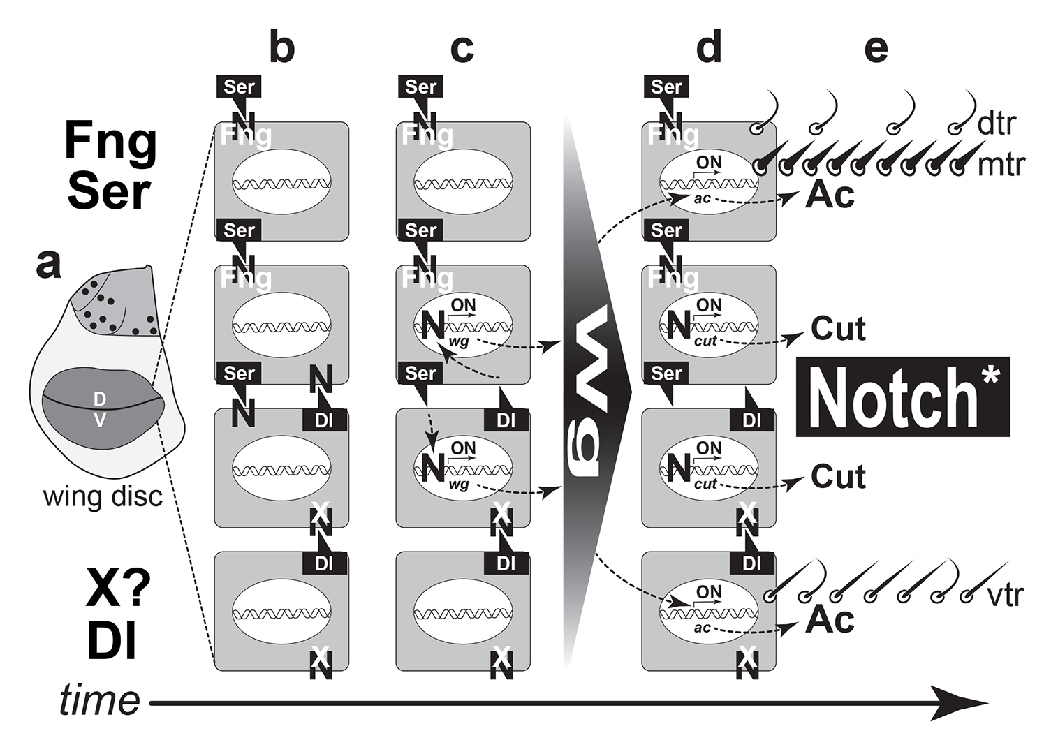
Notes:
Specification of wing margin by the Notch pathway. This figure shows how the mirror plane at the D/V boundary arises. As in the case of the eye—and the deviant double-joint syndrome—the explanation revolves around how the Notch pathway operates at boundaries. a. Mature right D. melanogaster wing disc. The future wing (dark oval) and half-notum (light gray) are indicated, as well as margin (horizontal line) and future macrochaetes (dots). The dorsal (D) half of the disc expresses Fng and Ser; the ventral (V) half expresses Dl and an unknown agent (X?). b-d. Schematic of four cells straddling the D/V line, shown at successive stages. b. Fng prevents Notch (N) from reacting to Ser, and X blocks N from reacting to Dl. Hence, the only real signaling occurs in cells where Ser binds N from above or Dl binds N from below. c. In those cells the N receptor is cleaved from the membrane, and its inner portion goes to the nucleus where it turns ON wg. Those cells secrete Wg, which forms back-to-back gradients (triangles). d. High concentrations of Wg turn ON ac, but ac is inhibited in cells that abut the D/V line by Cut; cut is turned ON by N. This inhibition splits the Ac band into two thin stripes. e. Ac enables cells to make sensory bristles along those stripes. A triple row (tr) of bristles ensues: the dorsal tr (dtr) and medial tr (mtr) arise from the upper stripe, while the ventral tr (vtr) arises from the lower stripe. N.B.: Curiously, the N-activated zone straddling the D/V line initially spans ≥10 cells, instead of the eventual two shown here, with the shrinkage in breadth being caused by nubbin. How can Dl activate non-adjacent cells? Conceivably, the signaling cells use filopodial extensions studded with Dl protein. Author’s aside: In conclusion, Chapter 4’s investigation of the double-joint mystery led us down a rabbit hole, where we were able to explore the intricate workings of the Notch pathway module under the influence of the PCP “app”—both of which belong to a toolkit inherited from the common urbilaterian ancestor of most animal phyla, who lived ~600 million years ago

Slide 12
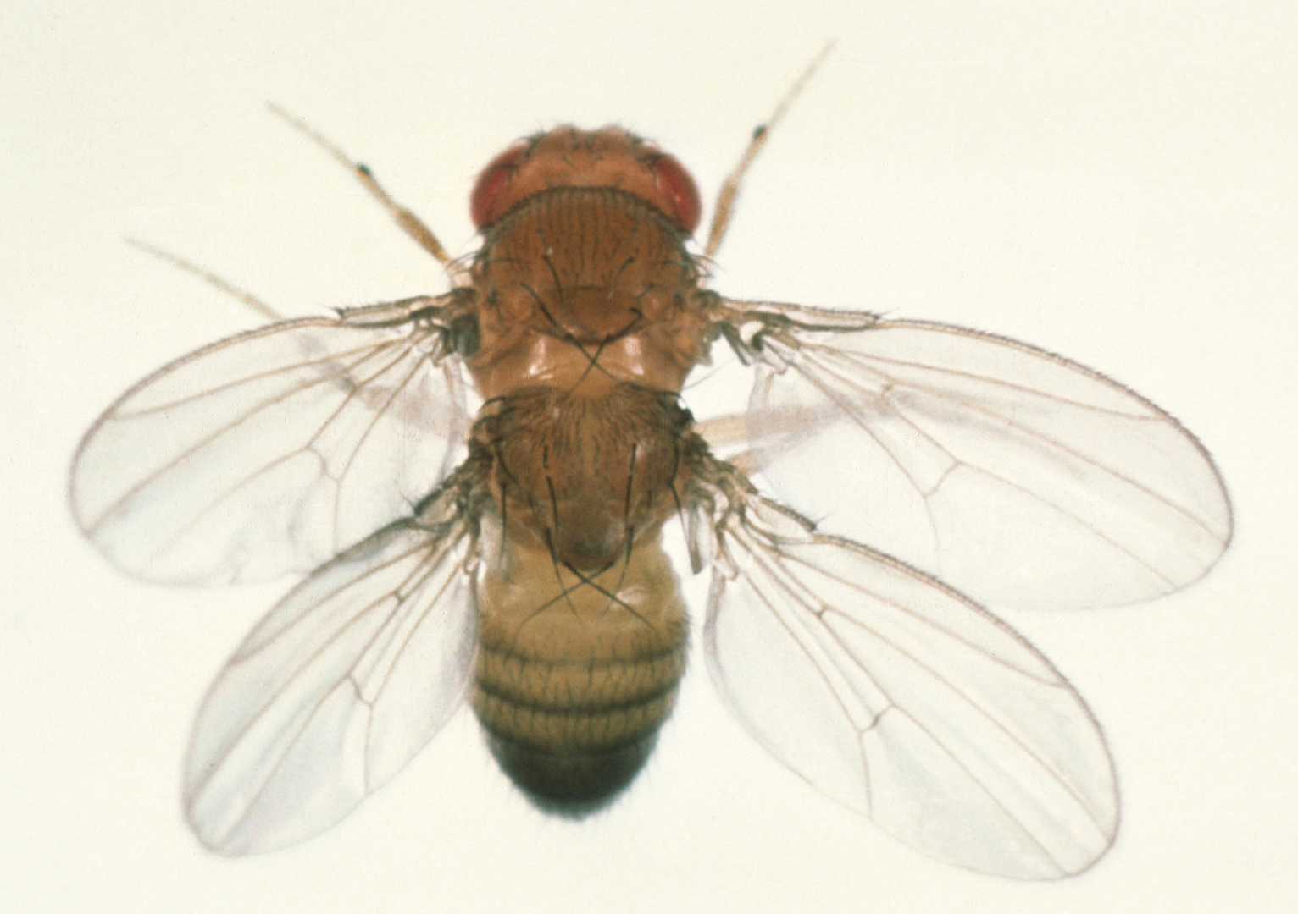
Chapter 5
What causes double-
thorax phenotype?
Notes:
Four-winged fly compared with a normal fly. There is no more famous mutation in the world than bithorax. The first bithorax mutant was found by Calvin Bridges in 1915, but it was Ed Lewis’s Nobel-Prize-winning analysis of the Bithorax complex in 1978 that led to the greatest epiphany ever unearthed by the field of evo-devo: the Hox Complexes. The story of how we got from the bithorax mutation to those complexes is retold in these figures from Chapter 5. This fly has four wings and two thoraxes. It is homozygous for three alleles of the Ultrabithorax (Ubx) gene: anterobithorax (abx), bithorax³ (bx³), and postbithorax (pbx). Collectively, they convert the third thoracic segment (T3) into a second thoracic segment (T2) and, in so doing, convert halteres—the bulbous protrusions behind the wings of a normal fly—into wings. This phenotype harks back to a dragonfly-like ancestor. Curiously, bithorax traits can be induced in non-mutant (wild-type) embryos by exposing them to ether vapor or heat treatment at the blastoderm stage for reasons we don’t fully grasp.

Slide 13
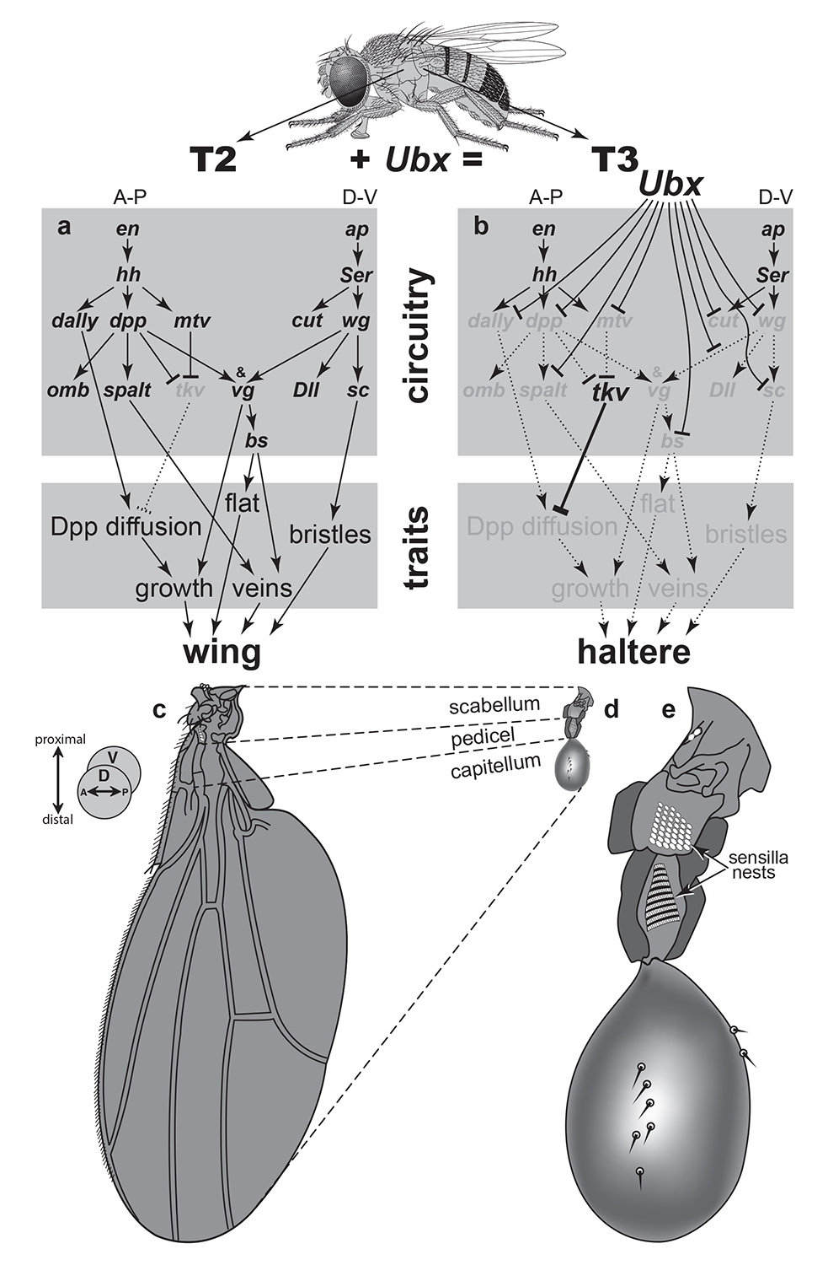
Notes:
Differences between wing and haltere development. a, b. Genetic circuitry (above) responsible for traits (below) in dorsal appendages of the second (T2) and third (T3) thoracic segments in D. melanogaster. A-P and D-V axes start with engrailed (en) and apterous (ap), respectively. Arrows denote activation; T-bars denote inhibition. Faded letters and dotted lines indicate absence or impotence. a. Wing development. b. Haltere development. Ubx inhibits genes at various levels of the hierarchy to transform the wing into a haltere. If Ubx is forcibly turned ON in T2, then it usurps the wing-making circuitry of that segment as well to turn the forewings into halteres. c. Upper (dorsal, D) surface of a left wing; ventral (V) surface beneath. Dashed lines denote homologous regions of the wing and haltere. d, e. Upper surface of a left haltere, drawn at the same scale as the wing (d) or enlarged 5X (e). The capitellum serves as an inertial mass, causing the stalk to bend during flight, with the resulting torque being sensed by arrays of sensilla in the stalk. Those arrays bear a striking resemblance to the transverse rows of bristles on the legs. Amazingly, halteres evolved independently in the T2 segment of Strepsipterans. No drosophilid or strepsipteran species has ever forfeited its halteres and returned to the ancestral four-wing state, but drastic atavisms have occurred for other structures.

Slide 14
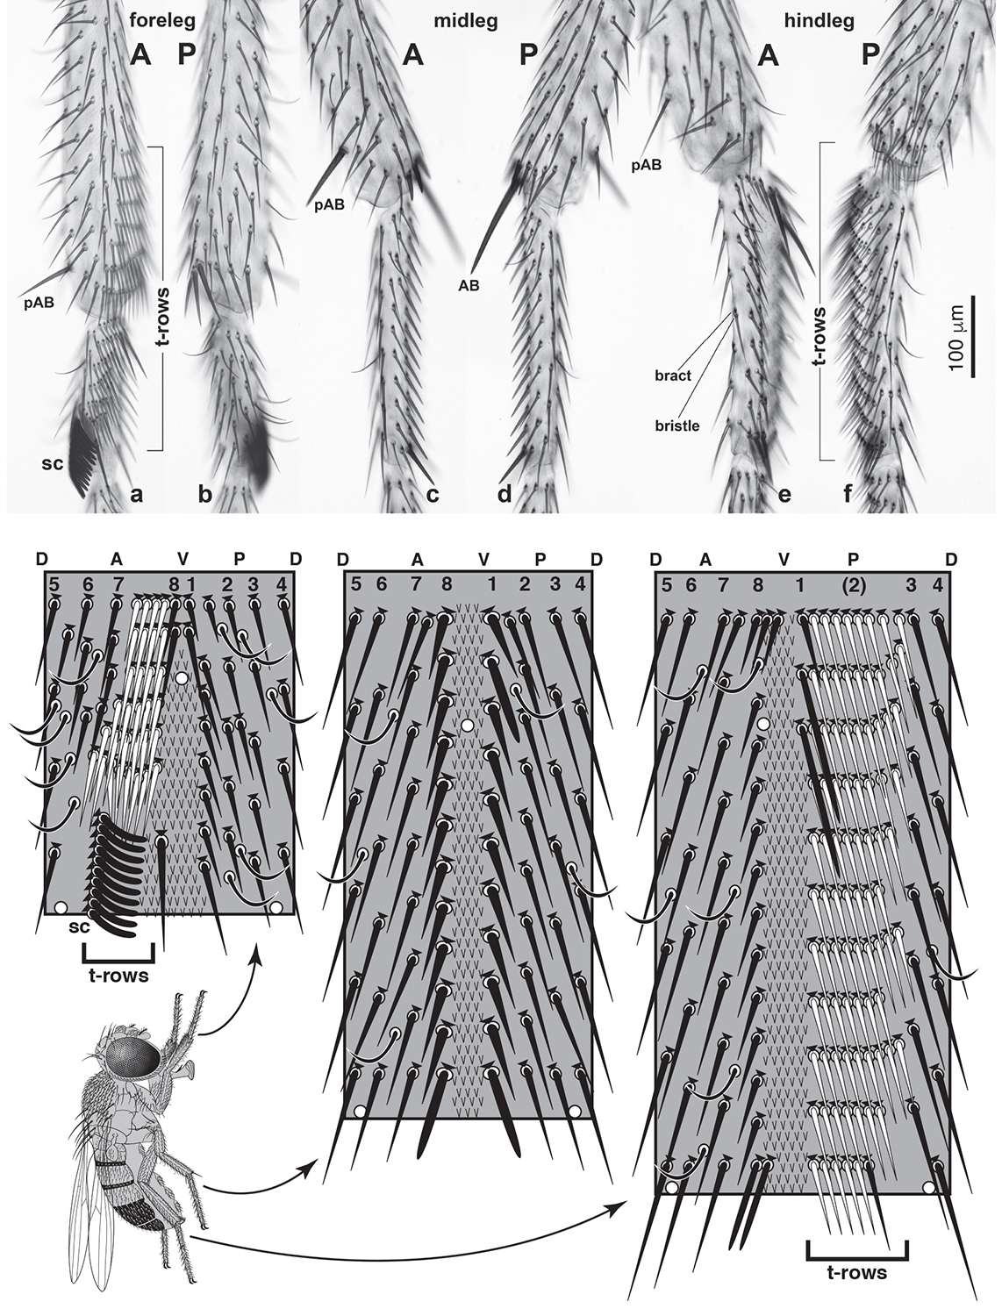
Notes:
Differences among forelegs, midlegs, and hindlegs. Ubx mutations are most famous for their effects on the dorsal appendages (haltere and wing), but they also affect the ventral ones: the legs. This figure introduces readers to the anatomical differences among the legs. The legs differ mainly due to enigmatic “apps” that organize bristles into transverse rows. a-f. Right legs (tibial and basitarsal segments only) of wild-type D. melanogaster males as viewed from the anterior (A) or posterior (P) side. Apical (AB) and pre-apical (pAB) bristles on the tibia are labeled, and transverse rows of bristles (t-rows) are indicated, along with the specialized t-row known as the sex comb (sc). All photos are at the same magnification as the scale bar in f. a, b. Foreleg. c, d. Midleg. This pattern is the simplest and presumed to be the most primitive. Note the thick, dark AB and pAB, which are examples of “macrochaetes” (big bristles), while the basitarsal bristles are examples of “microchaetes” (small bristles). e, f. Hindleg. Diagrams below are panoramic maps of bristle patterns characteristic of the basitarsal types above, drawn to the same scale, as if segments were slit along the dorsal (D) midline, unrolled, and flattened. In each longitudinal row (1-8), the bristle lengths and bristle intervals increase with distance from the ventral (V) midline. The foreleg has t-rows on its A side, the hindleg on its P side. In both cases the t-row bristles tend to be lighter (yellow vs. brown), and they abut a stripe of (non-sensory) hairs (“v”s) between rows 1 and 8. Black triangles above bristles are bracts. Mechanosensory (straight) bristles all have bracts; chemosensory (curved) bristles lack them. The three white circles per segment are sensilla campaniformia (stretch detectors). Drawings are idealized insofar as (1) basitarsi are not perfect cylinders, (2) trichoid hairs are not arranged so neatly, and (3) segment widths are exaggerated.

Slide 15
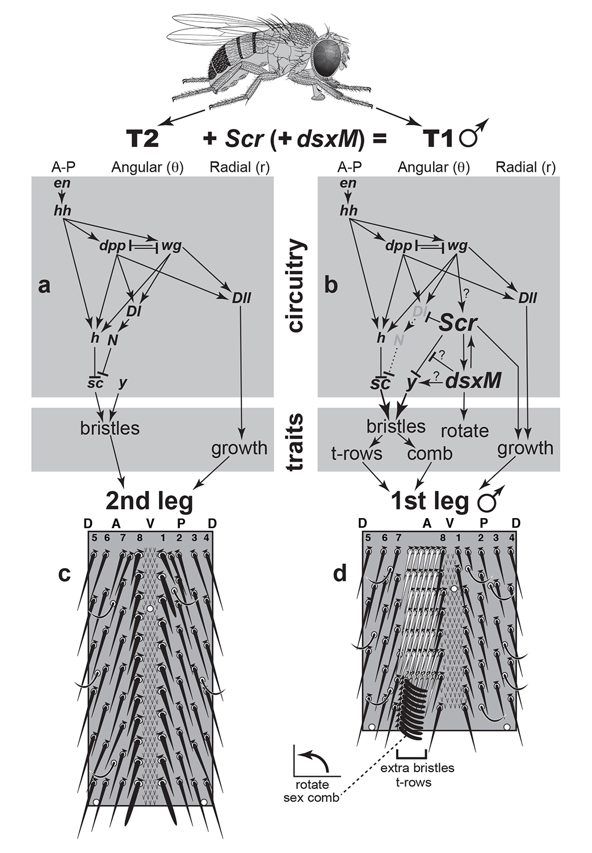
Notes:
Differences between midleg and foreleg development. Whereas Ubx is used to convert a midleg into a hindleg, a separate homeobox gene—Sex combs reduced (Scr)—is used to convert a midleg into a foreleg. a, b. Genetic circuitry (above) responsible for traits (below) in ventral appendages of the second (T2) and first (T1) thoracic segments in D. melanogaster. As in the wing disc the leg disc uses engrailed (en) to launch its A-P axis, but its D-V axis does not use apterous. Instead, it employs wg and dpp, both of which are activated by Hh diffusion across the A/P boundary. Together wg and dpp endow cells with angular (q) coordinates and turn on Distal-less (Dll), which gives them radial (q) coordinates within a polar coordinate system. Arrows denote activation; T-bars indicate inhibition. Faded letters and dotted lines signify absence or impotence. a. Midleg development. b. Foreleg development. Scr inhibits signaling of Delta (Dl) to Notch (N) between rows 7 and 8 so as to boost scute (sc), spur growth, and sprout bristles. It also inhibits yellow (y), thereby turning the novel t-row bristles yellow. Larger font sizes and thicker arrows denote increased expression. A male-specific splice variant of the sex-determining gene doublesex (dsxM) is co-expressed with Scr distally, and together they sculpt the last t-row into a sex comb and cause it to rotate. At that spot dsx overrides Scr’s inhibition of y and evidently stimulates y directly as well to make the comb bristles black. Like Ubx, Scr and dsx operate as micromanagers. c. Panoramic map of bristles on the midleg basitarsus. d. Panoramic map of bristles on the foreleg basitarsus. Changes relative c include: (1) insertion of t-rows, (2) reduction in t-row pigment, (3) conversion of one t-row into a sex comb, (4) increase in comb pigment, and (5) rotation of the comb. We do not yet know how Scr shortens the basitarsus.

Slide 16
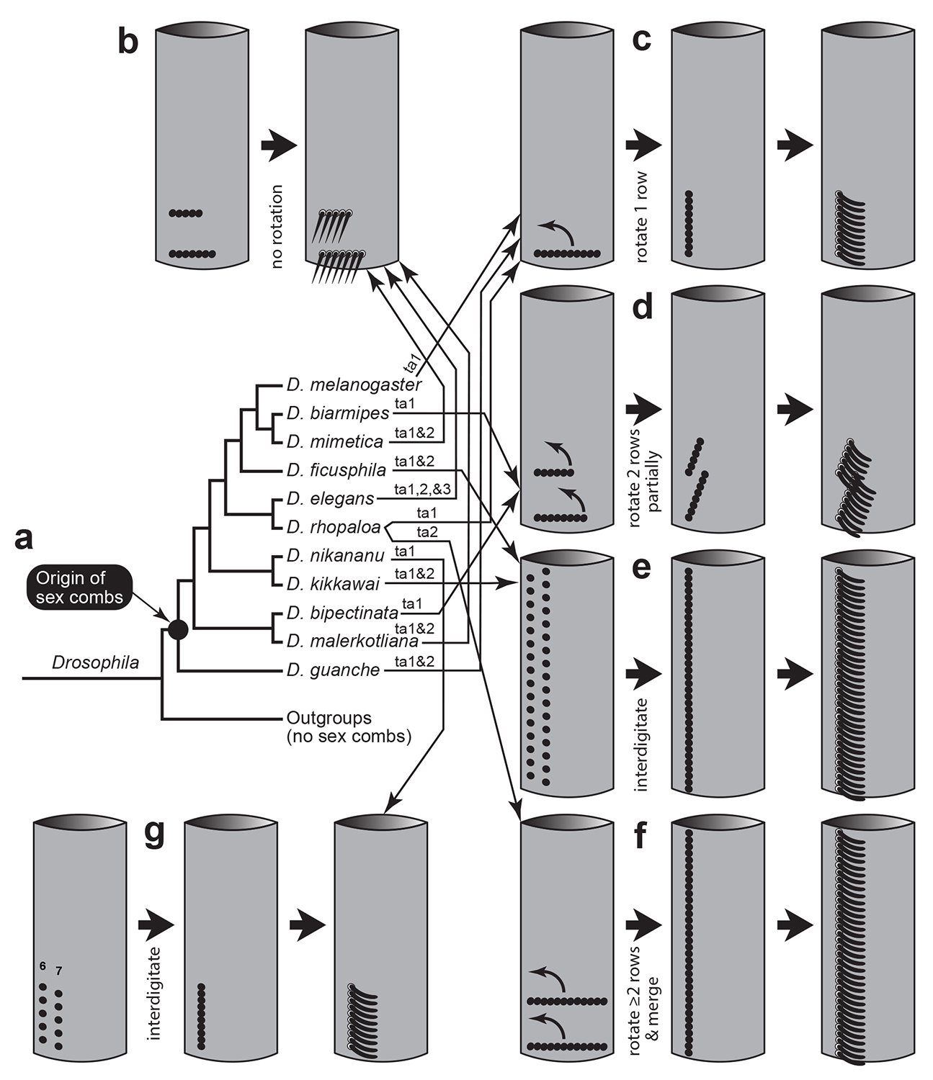
Notes:
Diverse strategies of sex comb development in Drosophila. Investigations of sex combs in other Drosophila species by Artyom Kopp and his collaborators have uncovered a trove of mechanisms for sex comb formation, whose diversity boggles the mind. How and why evolution employed so many different “apps” to construct so many configurations is baffling. All we know for sure is that Scr and Dsx are used in all cases to launch those apps appropriately. a. Phylogeny of species in the genus Drosophila (subgenus Sophophora) that possess sex combs on the male foreleg. Arrows connect species (a) with the processes used to craft their sex combs (b-g). Labels above arrows denote tarsal segments (ta1, ta2, etc.) that exhibit the designated style of development. b-g. Modes of sex comb formation. Each cylinder represents a tarsal segment from a right foreleg, with black dots marking bristle cell precursors. Bracts are omitted, as are bristles outside the sex comb proper. Curved arrows describe the arc of rotation. b. Combs that do not rotate have less distinctive, albeit pigmented, bristles—i.e., tapered and straight, instead of blunt and curved. c. The style of rotation in D. melanogaster is also used by a few distantly related species. d. Rotation of more than one transverse row. e. Bristle cells from rows 6 and 7 interdigitate to form a comb that spans the whole segment (cf. g). f. Rotation of parallel rows that then merge to form a segment-spanning comb. An extreme version of this style is used by a species outside the Drosophila genus: Lordiphosa magnipectinata rotates and merges ~6 t-rows to make a single ta1 comb. g. Same interdigitation mode as in e, but here the comb is confined to the distal part of the segment. The final comb looks remarkably like the sex comb of D. melanogaster, but it is created by an entirely different process.

Slide 17
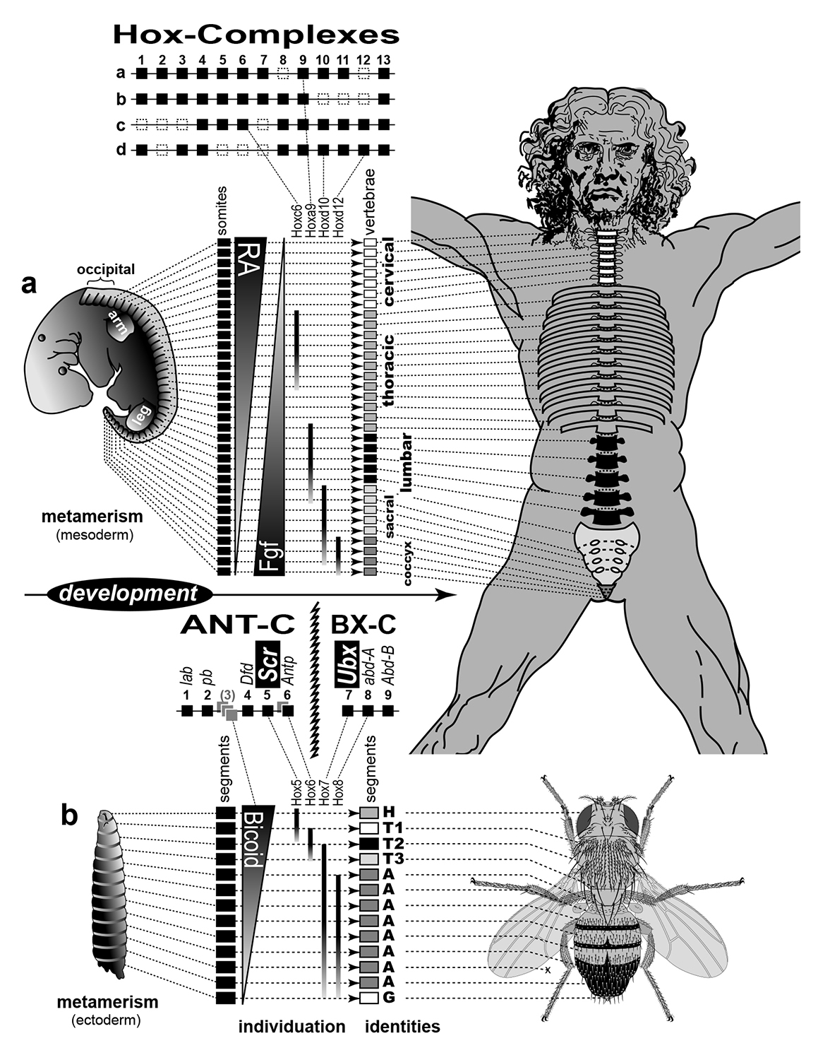
Notes:
Hox Complexes of humans and flies. Ubx and Scr are members of an ancient family of homeobox genes that are shared by virtually all bilaterally symmetric animals, including humans and flies. In both of these instances the Hox complexes are used to establish area codes along the anterior-posterior (head-tail) axis of the body. However, that axial coordinate system is mainly mesodermal in humans and ectodermal in flies, and the modular units differ as well (somites in humans vs. segments in flies). Therefore, the Hox code functions like an abstract operating system which can launch a variety of downstram “apps”. a, b. Stages of development (left to right) are metamerism (rectangles), regionalization (gradients), individuation (Hox zones), and differentiation (shades of gray), starting with a 31-day human embryo (a) or fly larva (b). The A-P axis is divided into mesodermal somites (a) or ectodermal segments (b). Positional information is specifed retinoic acid (RA) and Fibroblast growth factor (Fgf; a) or Bicoid (b). Hox genes provide “area codes” for tagmata (groups of metameres) by overlapping zones of transcription (vertical bars that fade posteriorly) in the same order as their sequence along the chromosome; a few expression zones are sketched to illustrate this colinearity. a. Humans have four Hox Complexes, though some genes (dotted outlines) have been lost. Tagmata include cervical, thoracic, lumbar, sacral, and coccygeal vertebrae. b. The single Hox-C of flies is split into a Bithorax-Complex (BX-C) that has Ubx (Hox7) and an Antennapedia-Complex (ANT-C) that has Scr (Hox5). Hox3 and Hox6 begat paralogs (gray squares) that no longer provide area codes, though two of them (bicoid and ftz) are still involved in A-P patterning. The story of how Ed Lewis discovered the BX-C is as fascinating as the story of how Howard Carter discovered King Tut’s tomb. Tagmata include head (H), thoracic segments (T1-T3), and abdomen (A).

Slide 18
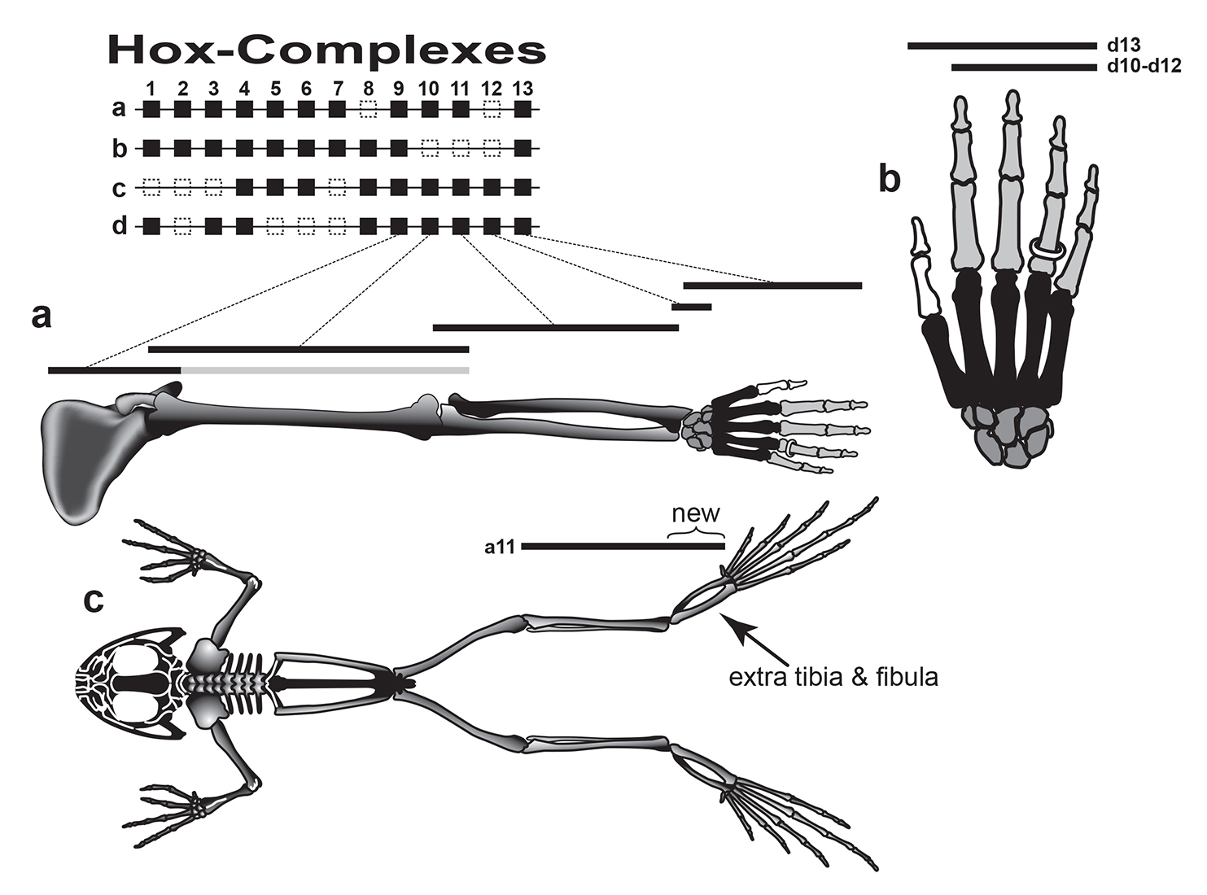
Notes:
Deployment of Hox-C genes within the vertebrate limb. Amazingly, evolution has deployed the Hox complexes for an entirely different kind of function in tetrapod vertebrates—namely to establish positional identities along the proximal-distal axis of the limb. Frogs have tinkered with those identities to acquire an extra tibia and fibula, and a similar trick was used by leaping mammals (tarsiers and galagos). a. The four Hox complexes (39 genes) of placental mammals (above). Hoxd9-13 are expressed in nested domains (lines) along the mouse limb (human left arm shown instead), together with their Hoxa9-13 paralogs (not shown). b. Hox gene expression in a human left hand. The “Hox code” of the thumb is d13 ON and d10-d12 OFF. Hence, the thumb can be converted into an ordinary finger (i.e., homeosis) by forcing it to express d12 (with its native d13). Null mutations in d13 have little effect due to the ability of remaining Hox-d genes to substitute for d13, while partial-LOF mutations in d13 cause polydactyly, syndactyly, and interdigital webbing instead of homeosis. c. Frog skeleton. Two of the nodular ankle bones evidently evolved to form an extra tibia (tibiale) and fibula (fibulare) by extending the expression of Hoxa11 distally (“new”) beyond its former limit. N.B.: The frog deviates from the vertebrate blueprint in other respects besides its extra tibia and tarsus—notably, in its reduced number of vertebrae. Differences in Hoxd9 expression between fore- and hindlimbs are shown by the shaded extension of the bar in a. Author’s aside: In conclusion, Chapter 5’s investigation of the bithorax phenotype led us down a rabbit hole, where we were able to explore how the Hox complexes create coordinate systems that allow the body to be broken down into metameric subunits (somites or segments). Hox complexes belong to the same ancient urbilaterian toolkit as the Notch and PCP signaling pathways (Chapter 4).

Slide 19
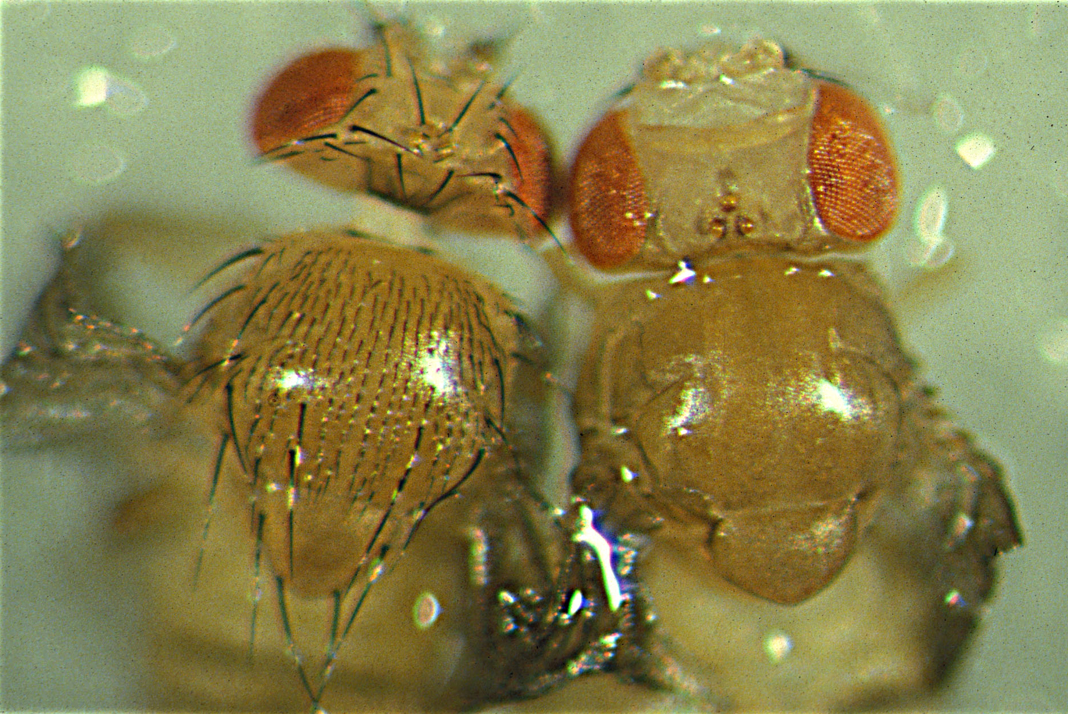
Chapter 6
What causes missing-
bristle phenotype?
Notes:
Wild-type fly and ac³ sc¹⁰⁻¹ mutant fly. One year after he found the bithorax mutant, Calvin Bridges found a fly that was missing a few bristles from the scutellar part of its thorax. He called the mutation “scute”. During that same year (1916) Alexander Weinstein, another student in Morgan’s lab, came across a fly that was missing bristles in front of the scutellum. He dubbed the mutation “achaete” (ac), meaning “no bristle” in Latin. It turned out that the scute and achaete genes are paralogs of one another. They belong to a gene cluster that is every bit as interesting as the Hox complexes. That “Achaete-Scute” Complex will be discussed in the next few figures. The mutant (right) is a male whose X chromosome has null alleles for the achaete (ac) and scute (sc) “proneural” genes, at least one of which must be functional in order for skin cells to become bristles, so the fly looks naked.

Slide 20
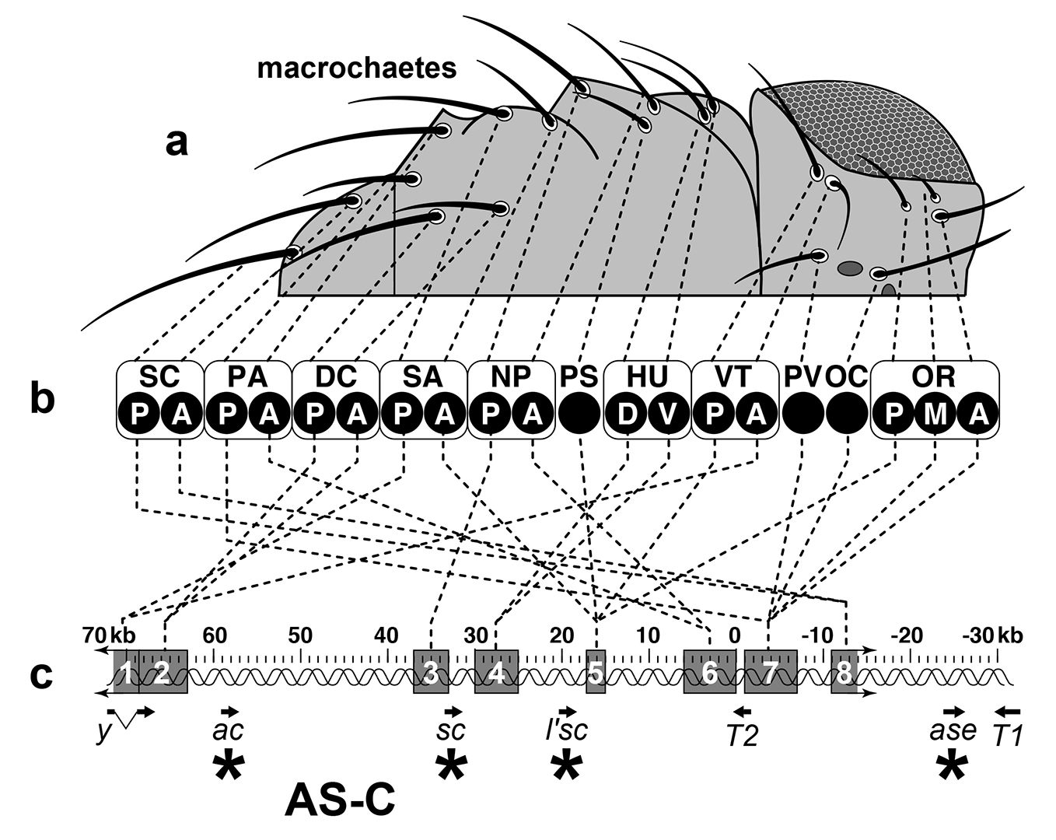
Notes:
Achaete-Scute Complex (AS-C). The AS-C is one of the best examples known of a genomic “Global Positioning System” (GPS) device. a. Left half of the head and thorax of a wild-type fly (dorsal view), showing only the 20 macrochaetes (large bristles). b. Black circles denote macrochaetes in order from back to front, with relative positions of the members in each pair or triplet marked as P (posterior), A (anterior), D (dorsal), V (ventral), or M (middle) within rounded rectangles. Abbreviations: SC (scutellars), PA (post-alars), DC (dorso-centrals), SA (supra-alars), NP (notopleurals), PS (presutural), HU (humerals), VT (verticals), PV (postvertical), OC (ocellars), OR (orbitals). c. The AS-C spans ~100 kb near the tip of the X chromosome; “0” is an arbitrary reference point. Asterisks mark the four AS-C genes—achaete (ac), scute (sc), lethal of scute (l’sc), and asense (ase)—that encode homologous bHLH proteins. None of them (arrows) has introns. T1 and T2 are unrelated transcription units, and yellow (y), which has a single intron (bent line), controls bristle pigmentation but appears to have its own set of enhancers. Dotted lines depict a genotype-phenotype “switchboard” connecting cis-enhancers (shaded boxes) along the DNA (double helix) with macrochaetes they control. Enhancers cause ac and sc to be expressed in “proneural clusters” that give rise to the indicated bristles—evidently via DNA looping that brings each enhancer into direct contact with ac and sc promoters. Double arrows indicate unknown limits. Among all of the enhancers the circuitry of the DC enhancer is best understood N.B.: A separate set of prepattern factors acts redundantly with these cis-enhancers to ensure an accurate final pattern. Microchaetes (omitted here) are smaller than macrochaetes because they arise later and have less time to undergo the endoreplication cycles needed for larger shafts. Macrochaetes also vary somewhat in length (e.g., pDC vs. aDC), and their sizes are also proportional to the extent of polytenization that they undergo after their SOPs finish mitosis. Higher dipterans evolved bigger bristles by shifting their inception to earlier stages via a novel enhancer, and this particular pattern has been conserved for ≥50 million years. Why are the enhancers of the AS-C scrambled relative to the sites that they control, in contrast to the Hox-C, where the genes are colinear with the anatomy? One obvious reason is that the pattern regulated by the AS-C is two-dimensional, not linear, so it would make little sense for its enhancers to conform to only one axis of the pattern.

Slide 21
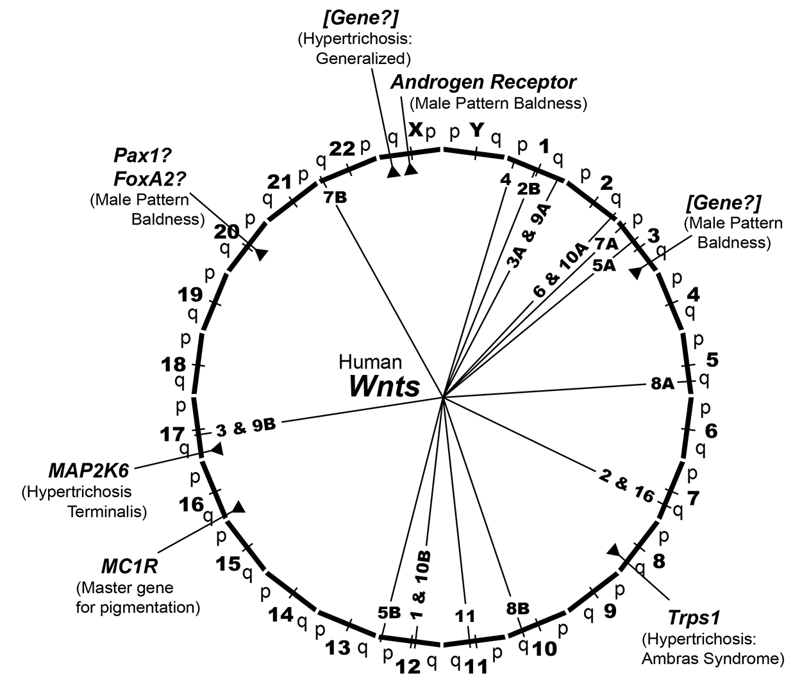
Notes:
Wnts and other hair-related loci in the human genome. Humans are nearly as naked compared to our simian cousins as null mutants of the AS-C locus are relative to wild-type flies. Not surprisingly, anthropologist Desmond Morris called Homo sapiens “The Naked Ape” in the title of his 1967 bestseller. Do we use an AS-C-like system of area codes to specify the hairs in our skin? If the AS-C were as universal among animals as the Hox-C, then we should expect to find one or more clusters of ac- and sc-like genes somewhere in our genome, and they should operate similarly to the fly’s AS-C. We do have ac and sc homologs, but they have nothing to do with hair formation. The evidence points instead to the involvement of the Wnt pathway in hair patterning, so the most likely place to look for an AS-C-like “Hair Headquarters” would be at one or more of the loci that harbor our 19 Wnt genes. Our 23 chromosomes are depicted here as facets of a wheel, with “p” and “q” arms having equal length and tick marks denoting centromeres. Our 19 Wnt paralogs are indicated by spokes, five of which are paired in close proximity. A few genes whose mutant alleles affect the amount of hair or pigmentation are mapped (arrowheads). None of them coincides with a Wnt, but one or more Wnt loci might still conceivably harbor a “circuit board” of cis-enhancers that delimit areas where terminal hair is allowed to grow within our skin.

Slide 22
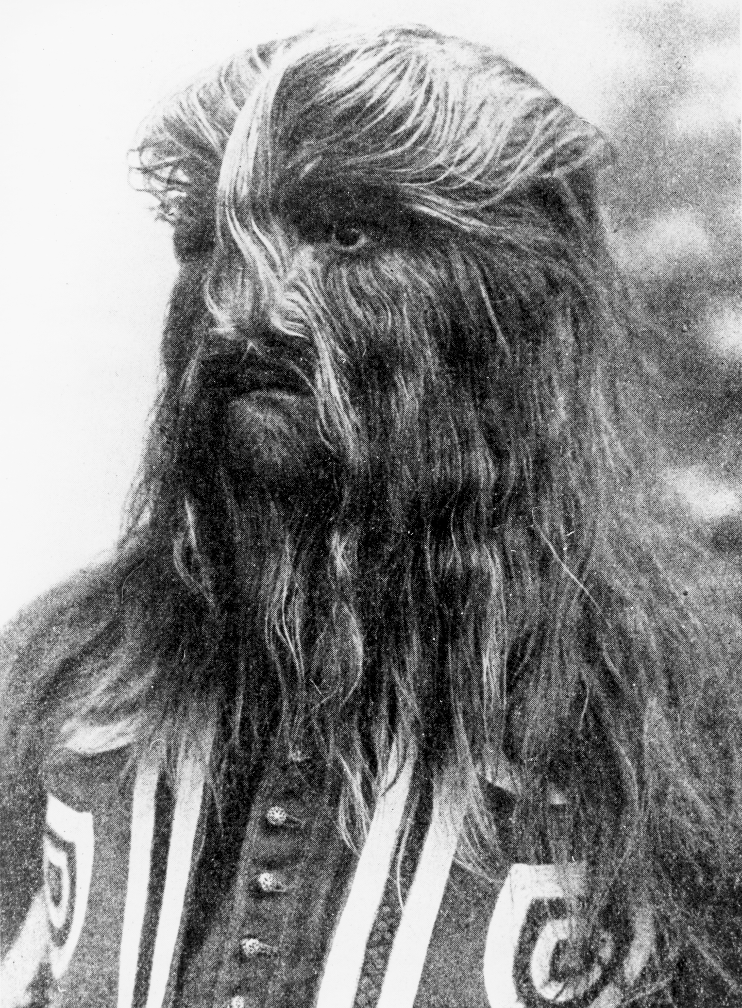
Notes:
Stephan Bibrowsky (1891-1931), age 16. Here is one of the hair-patterning syndromes mentioned in the previous figure. Born in Poland to normal parents, Bibowsky adopted the stage name of “Lionel, the Lion-faced Man” and toured with the Barnum and Bailey Circus. His extravagant hair was due to Ambras Syndrome. Such people were once thought to be throwbacks to our chimp-like ancestors, but none of the great apes actually have furry noses. If such syndromes were truly atavistic, then we might expect to see a return of the kinds of catlike whiskers (vibrissae) that characterize more primitive primates

Slide 23
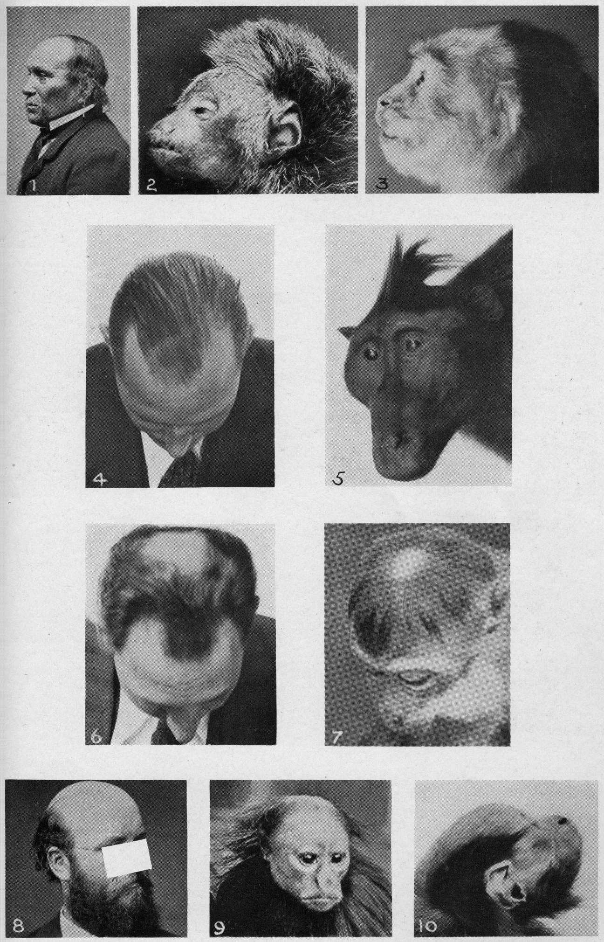
Notes:
Balding in humans compared with hair loss in monkeys. It turns out that male-pattern balding did not evolve in humans alone. Rather it is found in a variety of monkey species as well, so our species probably inherited it from one of our simian ancestors. The left picture in each panel depicts a type of male-pattern balding: (1) raised hairline, (4) receding temples, (6) vertex spot, or (8) bald crown. The picture(s) to the right are of monkeys with similar patterns of hair loss or coloration: (2) monk saki, Pithecia monachus; (3) monk saki with lighter hair color in the affected area; (5) Celebes crested macaque, Pithecia monachus; (7) toque macaque, Macaca sinica; (9 and 10) nearly bald crown in a red uakari, Cacajao calvus. Remarkably, the perimeters of men’s bald areas are as sharp as the edges of normally hairy areas (e.g., the eyebrow/forehead boundary) even though there is no hint of such contours in a male’s scalp before middle age, so all of these territories might be specified by the same kind of area codes. This montage comes from a treatise by Gerrit Miller, Jr. Used with permission from the Smithsonian Institution.

Slide 24
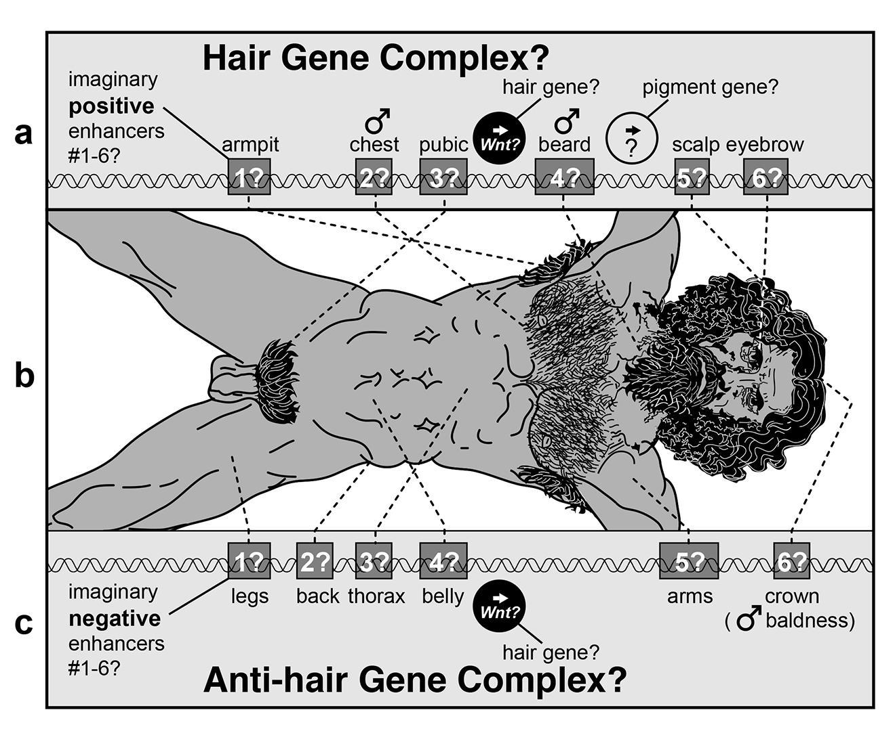
Notes:
Hypothetical Hair Headquarters (HHQ) for the Homo sapiens. The hairy regions of humans (b) can be viewed from two different perspectives, in the same way that a figure-ground illusion can be parsed in alternative ways. Assuming that one of our 19 Wnt genes serves as the hair-promoting master gene, then it might be activated in hairy areas (a) or inhibited in hairless ones (c). In the latter case, our cis-enhancers would not be activators for hairy areas (scalp, armpits, groin, etc.) analogous to the AS-C, but rather would act as inhibitors to suppress hair formation in the remaining areas of the body (torso, legs, forehead, etc.). Regardless of whether our HHQ operates in a positive or negative mode, its circuitry might resemble that of the AS-C. If so, then it might be expected to have ~6 cis-enhancers (shaded rectangles) whose order along the chromosome is scrambled (dotted lines) relative to the regions they control. The HHQ might also contain a pigment gene (a) to assign hair color, though the pigment gene in the AS-C (yellow) does not appear to share enhancers with ac and sc. It would not make sense for a pigment gene to reside in an Anti-hair Gene Complex (c) since hairless areas do not vary much in pigmentation. Why our species has this odd landscape of hairy tufts is unclear, as is the mystery of what our extinct hominin relatives might have looked like since hair does not fossilize. Adapted from Leonardo da Vinci’s Vitruvian Man (ca 1492).

Slide 25
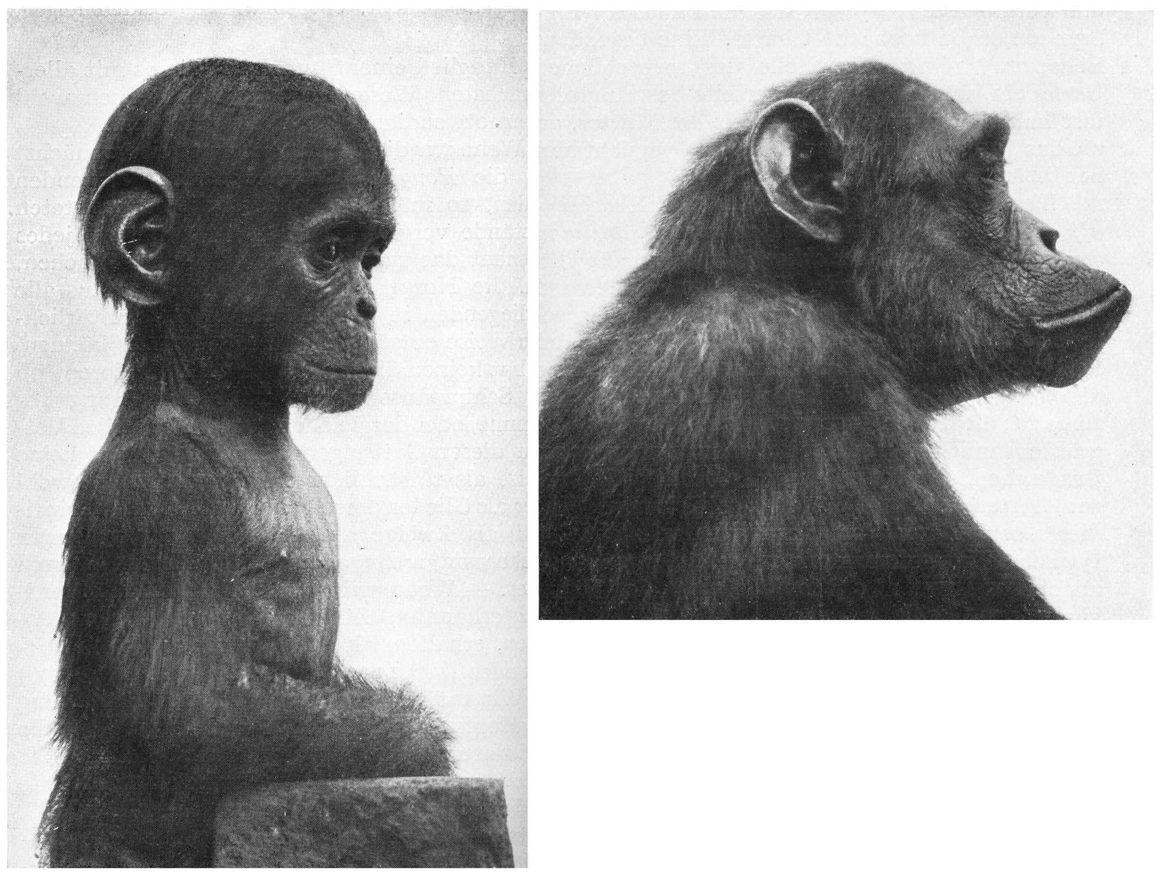
Notes:
Facial features of a baby chimp relative to an adult chimp. There is another way of thinking about how we acquired our nakedness, which depends upon temporal, rather than spatial control of hairiness. “Heterochrony” is the general term for timing changes in the development of a descendant relative to an ancestral species, and “neoteny” is a type of heterochrony where the descendant exhibits the same traits as the ancestor but with a much delayed schedule. Humans are demonstrably neotenous with regard to our fellow apes. The most obvious example is our wisdom teeth, which erupt late. Another example is the flatness of our face, which resembles that of a baby chimp, minus the muzzle that characterizes the adult. The striking resemblance of the baby’s flat face to that of an adult human was one of the many clues that led Louis Bolk to propose “fetalization” as the primary driving force of hominin anatomical evolution. Another corroborating clue is the baby’s relatively hairless chest. This argument animated Gould’s 1977 monograph Ontogeny and Phylogeny, wherein he buttressed Bolk’s hypothesis.

Slide 26
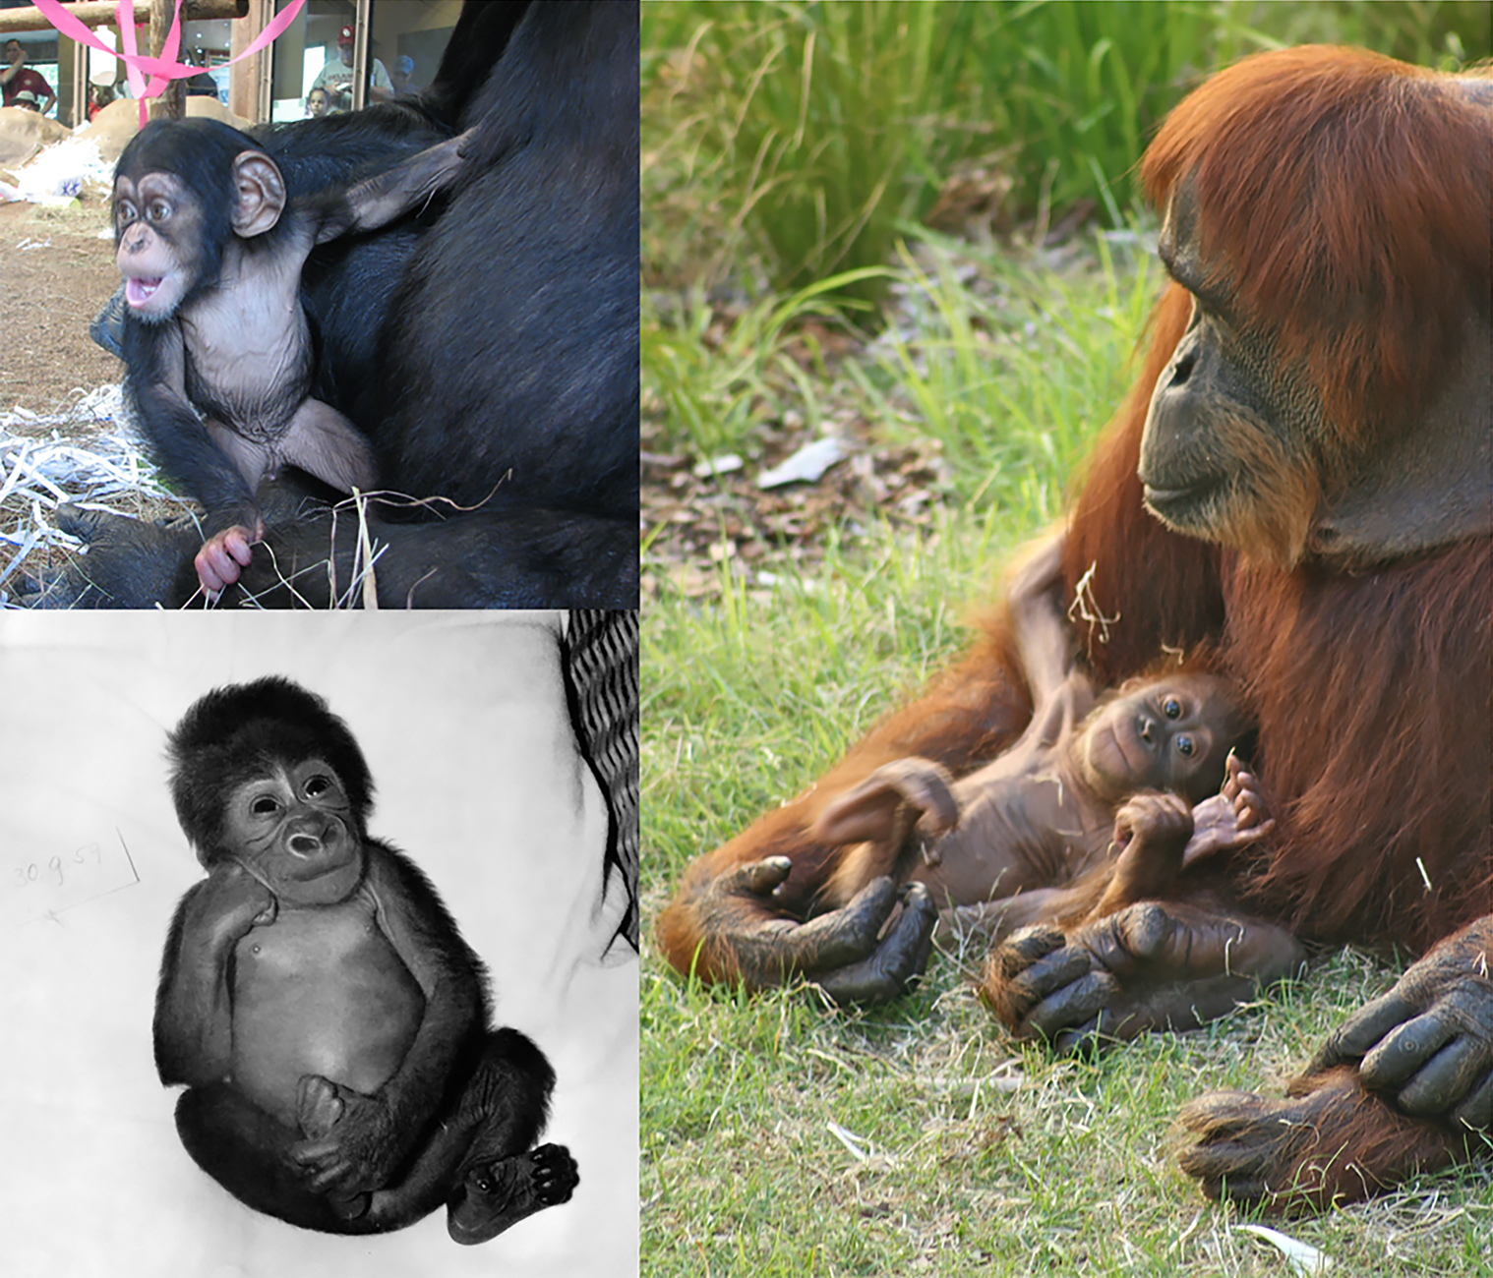

Slide 27
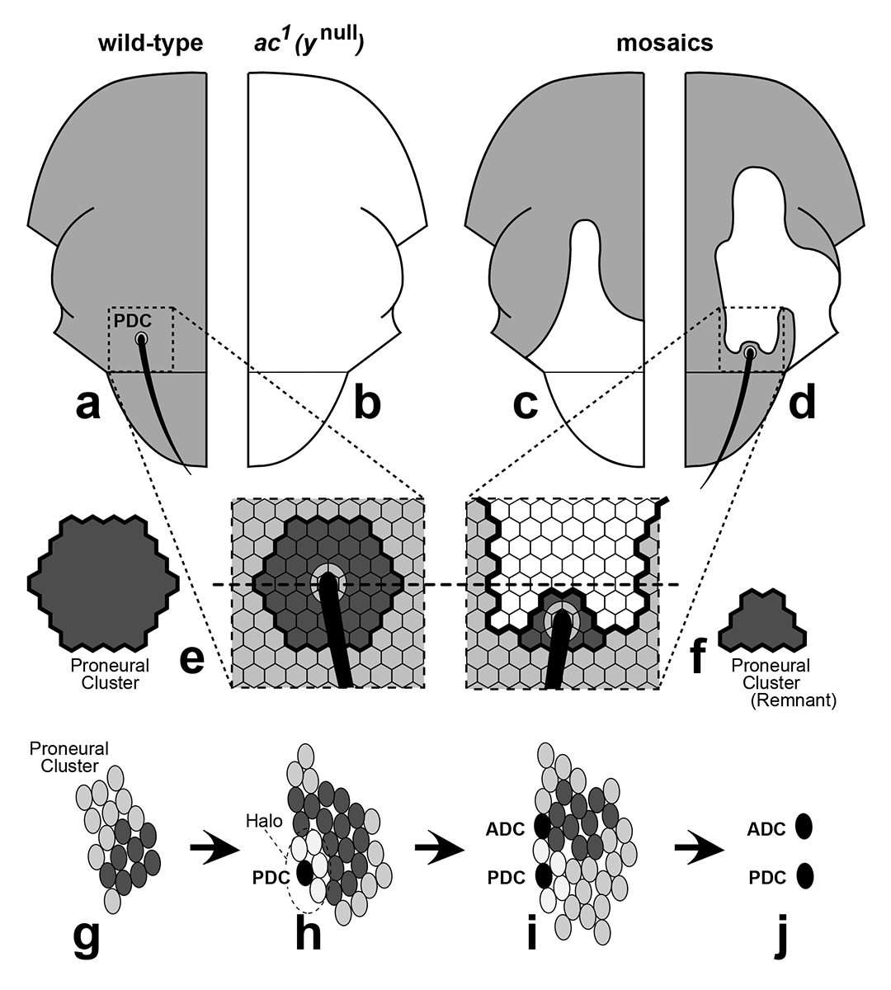
Notes:
The 1954 experiment that unveiled proneural clusters. a-f. One of the strangest aspects of ac and sc mutations is that they only remove specific subsets of bristles. Curt Stern was intrigued by this, so he undertook a now-famous investigation of achaete¹ (ac¹) “mosaics”. a. Half-thorax of a wild-type D. melanogaster, showing one of the 20 macrochaetes that exist on this side: the posterior dorsocentral (PDC) bristle. b. Half-thorax of an ac¹ fly, which lacks a PDC. Besides ac¹ the X chromosome also carried a null mutation (y¹) in the yellow gene. That allele causes bristles and cuticle to be yellow (depicted as white) instead of brown (gray in a), which allows the contours of any y¹ territory to be traced in a wild-type background. The chromosome also carried a LOF mutation (sn¹) in the singed gene. That allele causes bristles to be gnarled. c. Half-thorax from a fly that began life as a ynull ac1 sn1/+ + + (XX) female heterozygote. At the first mitosis of the zygote, one daughter nucleus lost its + + + X chromosome to become male (X0) and to express all three recessive mutations. At that point the fly became a mosaic (two genotypes in the same body), as well as a gynandromorph (half-male, half-female). In this case the X0 tissue happened to cover the entire PDC region, suppressing the PDC via ac1. d. Half-thorax from a similar mosaic, where X0 tissue barely overlapped the PDC site. Surprisingly, a wild-type bristle arose at the edge of the yellow area. e, f. Illustrations based on Stern’s interpretation of bristle displacement. Small hexagons are cells. Dashed line marks the normal PDC site. e. Stern reasoned that the ability to become a PDC must extend over a wider area than the single-cell site where the PDC normally arises. That area of bristle potential was later termed a “proneural cluster” (dark shading). f. As for the ectopic PDC (d), Stern deduced (1) that the mutant tissue must have blocked most cells in the cluster from becoming an SOP, leaving only a tiny cohort of “competent” XX cells, one of which became the SOP, and (2) that an SOP must have the ability to inhibit its neighbors from becoming SOPs. The only riddle that Stern did not figure out was why the cell in the center of the cluster (or its remnant) becomes the SOP. g-j. Confirmation of Stern’s 1954 logic by histological evidence in 1989. Drawing of a real cluster on a right half-thorax at ~25, 20, 10, and 0 h before pupariation, as revealed by antibodies to Scute. Ovals are cell nuclei. The DC cluster (1) has an irregular shape, (2) grows, and (3) yields two macrochaete SOPs along its edge. g. Some cells express more Scute (dark shading) than others. h. The SOP for the PDC (black) arises in a high-Scute area and acquires a halo of low-Scute cells. i. As the cluster grows, the high-Scute area shifts and the ADC (no halo yet) arises. What causes this shift is unknown. j. In this cluster, non-SOP cells stop expressing Scute before SOPs, which do so later (before dividing). Growth widens the ADC-PDC gap. As for why both bristles form on the medial (dorsal) side of the cluster, the reason appears to be that a diffusible bristle-promoting signal (Dpp) enters from that side.

Slide 28
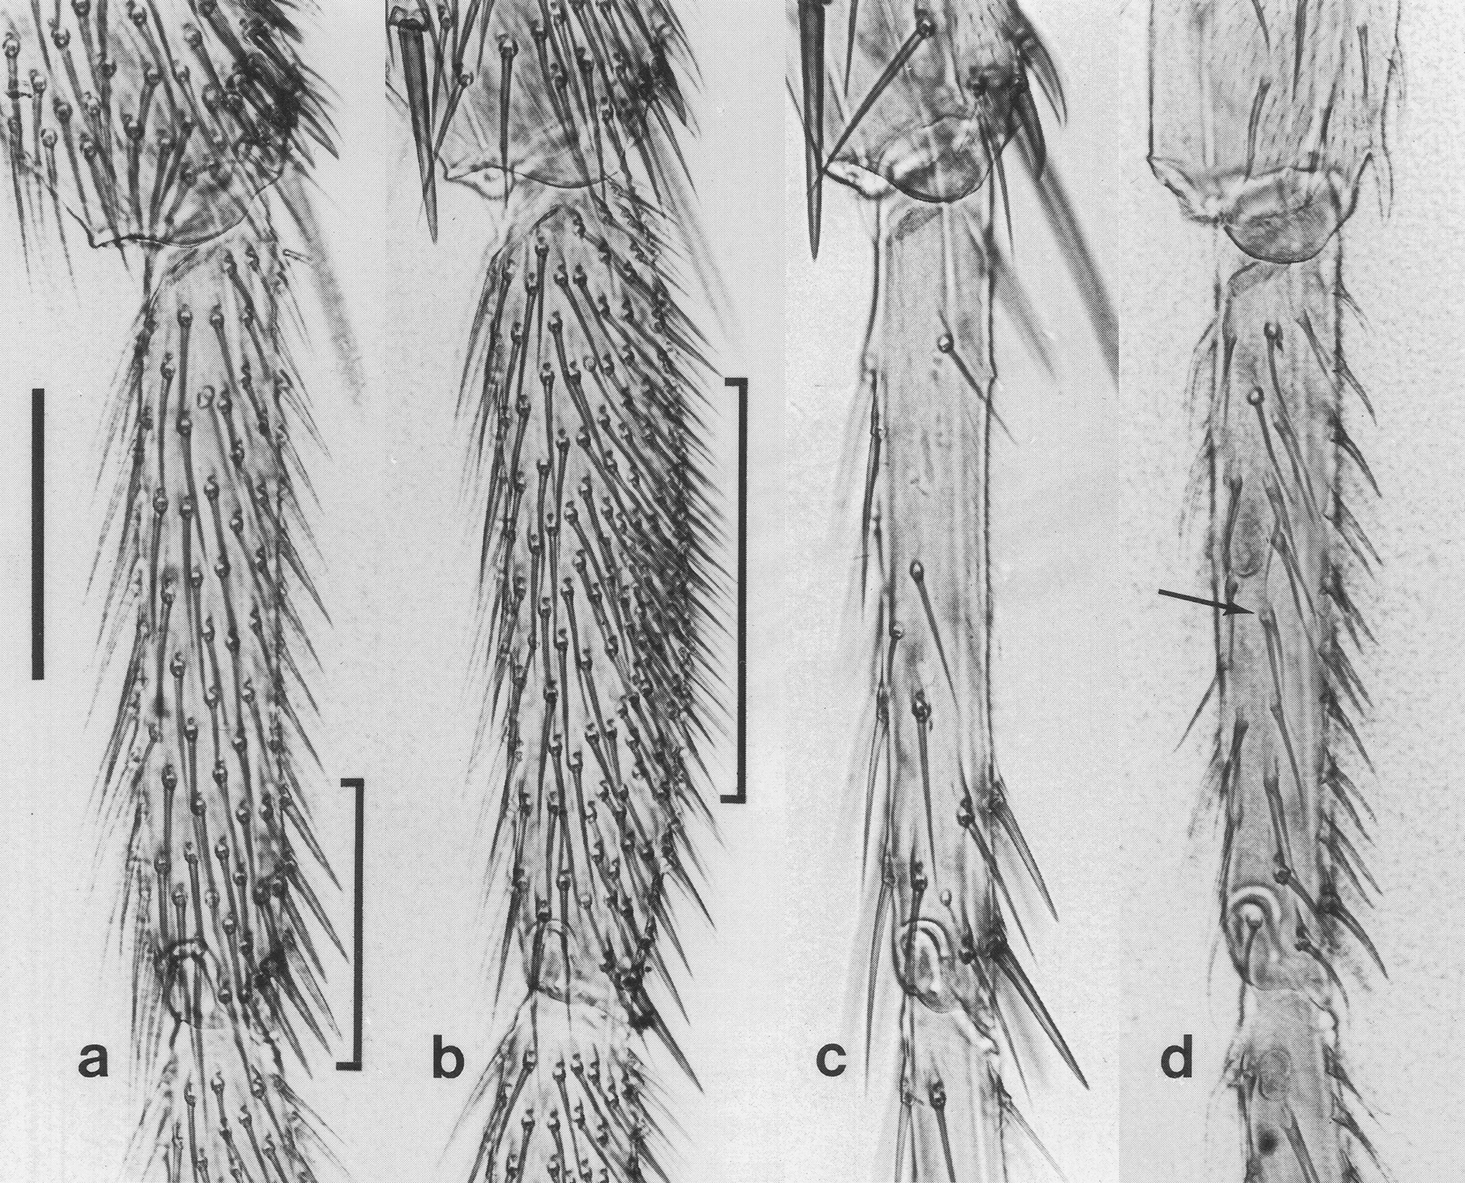
Notes:
Bristle abnormalities in temperature-sensitive mutants. The cis-enhancers of the AS-C do not pinpoint macrochaete sites at single-cell resolution. Rather, they merely denote rough areas around those sites. How rough? The “proneural clusters” (PNCs) that they evoke can contain as many as 20-30 cells. Within each such an equivalence group a single Sensory Organ Precursor (SOP) cell must somehow be chosen, and nearby cells must be stopped from becoming SOPs. The latter is achieved by “lateral inhibition” mediated by the Notch pathway. When that pathway is disabled, all PNC cells can make a bristle. However, disabling the Notch pathway is tricky. Ordinary loss-of-function mutations are lethal because it is used in the embryo in various roles. Only by employing a conditional allele were researchers able to block the pathway during the time when it is being used for lateral inhibition. Each photo shows the anterior side of the right second-leg basitarsus from a Notch pathway D. melanogaster mutant exposed to a pulse of high temperature (29˚C) during the pupal stage; hAP = hours after pupariation. a, b. Basitarsi from N^{ts1} males exposed to a 6-hour pulse of 29˚C starting at 2 or 7 hAP, respectively. Brackets denote areas of highest bristle density, which make sense based on the maturation sequence of bristles sites. Total numbers of bristles per segment are 150 (a) and 316 (b), which constitute a doubling or quadrupling of the usual number (~75). Note that the extra bristles are distributed farily evenly within affected areas, rather than forming discrete tufts, as they do at macrochaete sites. c. Basitarsus from a N^{ts1} male exposed to a pulse starting at 13 hAP. Most bristles are missing, except the most dorsal and distal ones. If Notch were only being used for lateral inhibition, then disabling the gene should only result in more bristles, not less. However, it turns out that the Notch pathway is also used for an unrelated function within the bristle cell lineage, as shown in the next figure. d. Basitarsus from a shibire^{ts1} male exposed to a pulse starting at 15 hAP. Most of the bristles (e.g., the one indicated by the arrow) have two shafts but no socket or bract—a defect expected if the socket cell were to transform into a shaft cell. The same phenotype is seen in N^{ts1} males pulsed at the same time, but at lower frequency. Scale bar (a) = 100 microns.

Slide 29
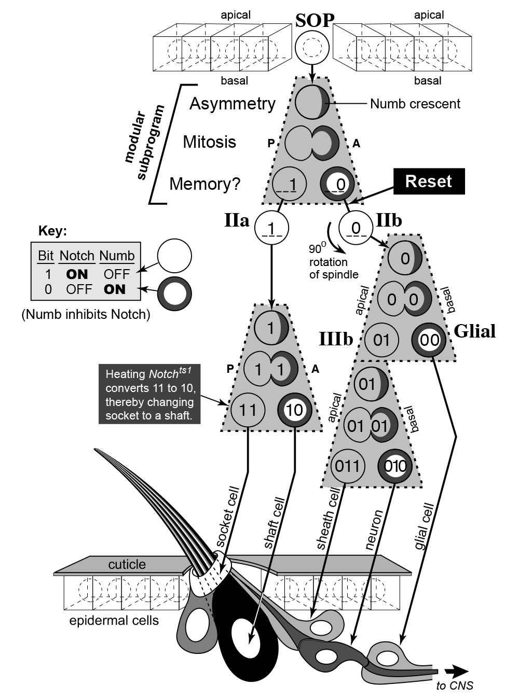
Notes:
Differentiation of a sensory organ precursor (SOP) into a bristle. This schematic shows how the Notch pathway is used after the SOP has been picked inside the PNC. At the top is a cutaway of the monolayer epidermis, with the SOP depicted as a sphere. The apical (cuticle-secreting) surface is above, the basal surface below. Anterior (A) is to the right, and posterior (P) to the left, as befits the thoracic or abdominal skin, though these directions would be proximal and distal, respectively, for the legs. The SOP arises from an ordinary epidermal cell within a proneural spot or stripe after having subdued its competitors via “lateral inhibition”. It then undergoes four mitoses (gray trapezoids), each of which entails: (1) asymmetric allocation of Numb protein to a crescent at one pole (anterior or basal) prescribed by the PCP pathway, (2) segregation of Numb into one of the two daughter cells, and (3) Numb-mediated stifling of Notch (1 → 0) in that daughter cell. “1” means activation of the Notch receptor (N*), transport of its inner part to the nucleus, and transcription of N* target genes, while “0” means suppression of N by Numb. The left-to-right order of 1s and 0s denotes each cell’s memory of prior states preserved as a binary code. Cellular generations are marked by roman numerals (I, II, and III), with “a” and “b” signifying sisters. The pIIa and pIIIb cells use N* to switch numb back ON, while the pIIb cell must purge (“reset”) its Numb state before it can re-boot the algorithm. The binary code (key) allows us to figure out the phenotypes obtained when N^{ts1} flies are exposed to heat pulses. Thus, a pulse during the first mitosis (not shown) would force both daughters (IIa and IIb) to adopt a “0” in their first binary register, causing all of their descendants to become glial, sheath, or neuron cells, leading to the “missing bristle” anomaly in the previous figure (panel d), whereas a pulse during the IIa mitosis would convert the socket cell (11) into a shaft cell (10), leading to the “double-shaft, no socket” anomaly.

Slide 30
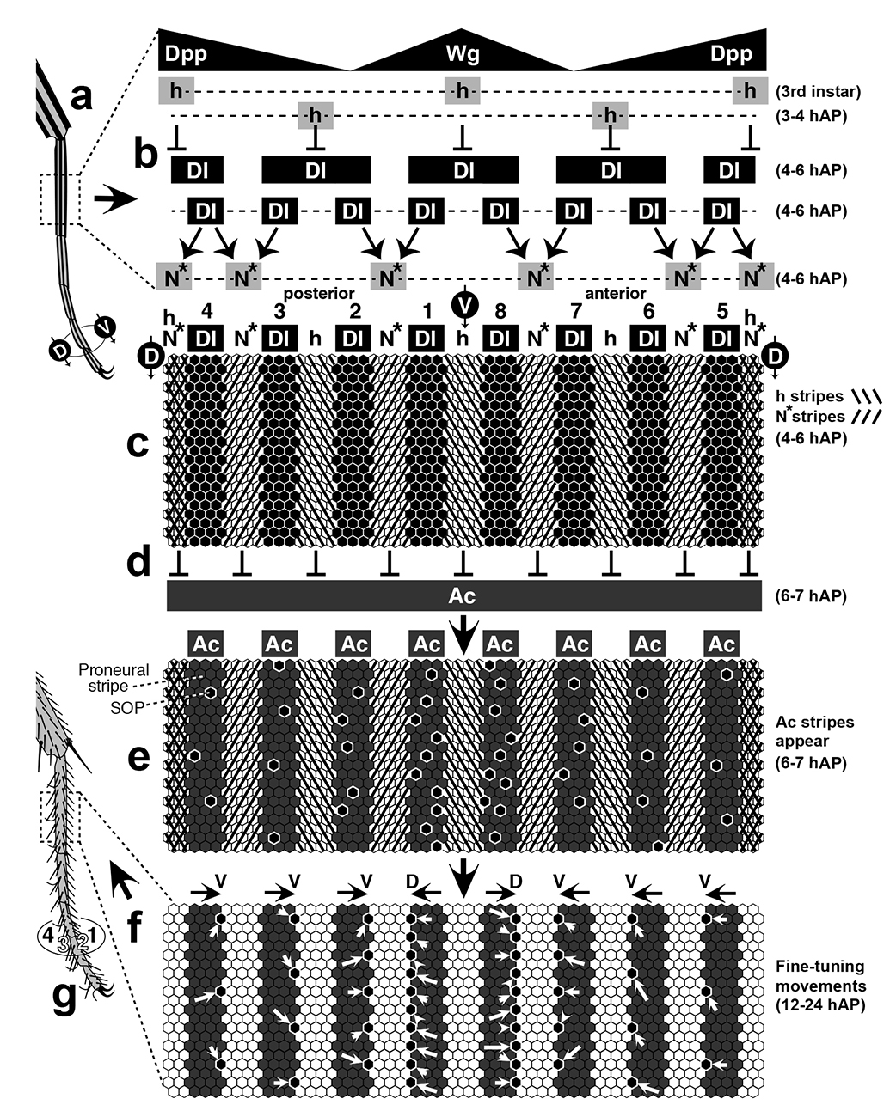
Notes:
Origin of microchaete SOPs from proneural stripes on the legs. The Notch pathway is used in one other major way during bristle development. As shown here, it is used to carve proneural stripes around the circumference of the tarsus, within which SOPs can percolate to form the longitudinal bristle rows. a. Tarsus of a left D. melanogaster second leg, with 3 of the 4 zones of hairy (h) gene expression (black stripes) visible from the posterior side, and dorsal (D) and ventral (V) midlines indicated on the circle at the bottom. (Pupal legs are actually stockier than depicted here.) b-f. Panoramic section of the basitarsus (dashed rectangle in a) that has been filleted along its D midline and laid flat, with cells drawn as hexagons. Times are given in hours after pupariation (hAP) along the right edge. b. Gradients (black triangles) of Dpp and Wg dictate the positions of all h and Delta (Dl) stripes directly. Two h stripes arise at the D and V midlines in the early 3rd instar; the other two h stripes arise soon after metamorphosis starts (3-4 hAP). Four wide stripes of Dl expression (4-6 hAP) get carved into 8 smaller ones by inhibition from h. Delta activates the Notch receptor (N*) on flanking cells. Arrows indicate activation; T-bars denote inhibition. Curiously, Dl fails to activate N inside h stripes, except at the ventral midline. As for why Dl fails to activate N insides its own (Dl) stripes, such cis Dl-N binding does not allow the N protein to be cleaved so that its inner part can go to the nucleus. c. N* and h-expressing stripes are hatched (key at right). Dl stripes are black. Bristle rows are numbered 1-8. d. Achaete (Ac) begins to be expressed around the whole segment but gets suppressed by N* and h stripes. e. The outcome is a kind of photonegative reversal, where 8 proneural Ac stripes (shaded) emerge in the spaces between the preceding N* and h stripes. Each Ac stripe spans ~3-4 cells, just like each of the N* and h stripes, which raises the question of how Dl was able to activate N over a distance of more than one cell diameter. As discussed previously, such a feat is possible if Dl-expressing cells extend filopodia to span the requisite distance (laterally in this case). Within the 8 Ac stripes, SOPs (black hexagons) emerge ~randomly. The number of final SOPs per stripe decreases with distance from the V midline. f. Movements of SOPs in a D (stripes 1 and 8) or V (other 6 stripes) directions, as inferred from cell-lineage analyses. These movements (white arrows) refine the alignment and spacing of bristles within each row. g. Adult tarsus, showing rows 1-4. Author’s aside: In conclusion, Chapter 6’s investigation of the Achaete-Scute Complex led us down a rabbit hole, where we were able to explore how the cis-enhancers assign area codes to sites within the fly epidermis. This analysis also allowed to appreciate the amazing extent to which evolution has relied upon the Notch pathway to fulfill important roles aside from boundary formation—namely, lateral inhibition and binary bifurcations—throughout development. As for why this pathway has been so often conscripted for these tasks, the reason is not hard to find: its ligands are transmembrane proteins whose juxtacrine range is confined to neighboring cells, unlike the diffusible ligands of the other major signaling pathways, whose paracrine ranges give them the ability to establish morphogen gradient

Slide 31
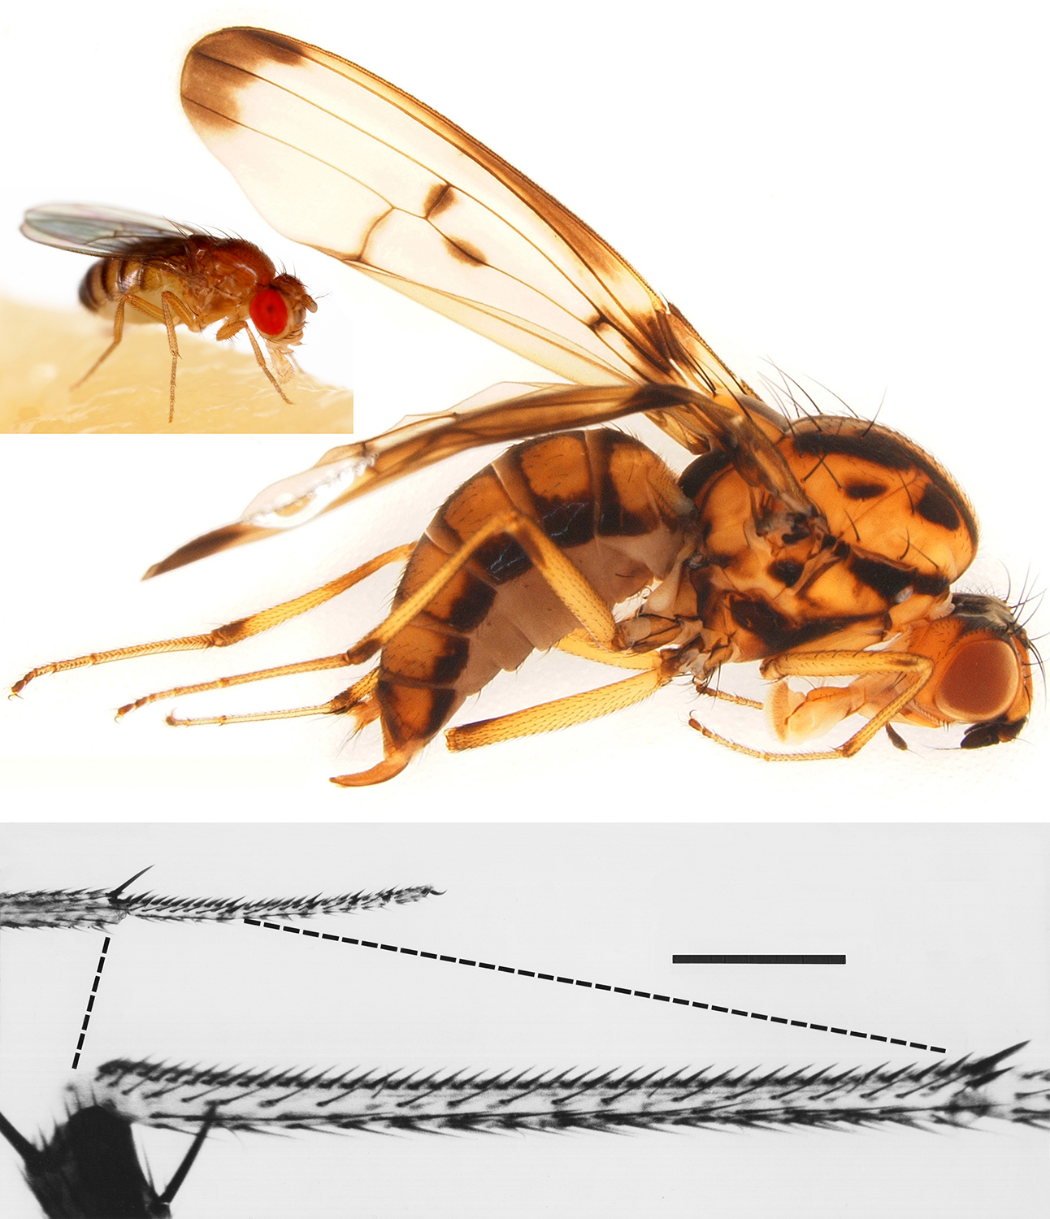
Notes:
Range of size in the Drosophila genus. Remarkably, the number of rows around the Drosophila tarsus has remained constant over a huge range of body size, presumably due to the fact that row positions are dictated by morphogen gradients (Dpp and Wg), as shown in the previous figure. Lewis Wolpert prophetically proposed that such gradients could easily explain why so many aspects of anatomy are scale-independent. The smaller fly in the upper panel is a D. melanogaster (body length ≈ 2 mm); the larger is a D. planitibia (body length ≈ 7.2 mm). Dashed lines in the lower panel delimit midleg basitarsi of D. saltans and D. planitibia. Despite the difference in basitarsal size (length ≈ 235 vs. 1,617 mm; circumference ≈ 94 mm vs. 245 mm) both leg segments have 8 longitudinal rows of bristles, but the number of bristles per row varies in proportion to segment length. The proportionality is due to constancy of bristle interval within each row, which in turn is attributable to a likely involvement of Turing-like devices for bristle spacing. Scale bar for lower panel = 300 mm. Author’s aside: This sampling of figures from Animal Anomalies should suffice to demonstrate how useful the analysis of outlier individuals has been in the history of developmental biology. William Bateson famously urged his junior colleagues to “treasure your exceptions.” Now we can see the wisdom of that advice.

